Slide 1
CECS 323
Mimi Opkins

Slide 2
  Introduction
Basic UML & SQL
  Models
  Classes & Schemes
  Rows & Tables
  Associations
  Keys
SQL technique
  SQL and RA
  DDL & DML
  Join
  Multiple Joins
  Join Types
  Functions
  Subqueries
  Union & Minus
  Views & Indexes
UML design
  Many-to-Many
  Many-to-Many 2
  Subkeys
  Repeated Attributes
  Multi-Valued Attributes
  Domains
  Enumerated Domains
  Subclasses
  Aggregation
  Recursive Associations
  Normalization
  BCNF
  Transactions
  JDBC

Slide 3
Introduction
What is a database?
Why do we need one?
  Avoid redundancy
    duplication of information in multiple tables within a database
  Data integrity
    Refers to the validity of data
  Referential Integrity
    ensures that relationships between tables remain consistent
  Deletion Anomalies
    Deletion of one row of a table results in the deletion of unintended information

Slide 4
Different Types of Databases
Paper
Flatfile
Hierarchical
Network
Relational
Object

Slide 5
Introduction – Redundancy
The duplication of information in multiple tables within a database
Ex. School Records may all have info about you
  Admissions
  Enrollment Services
  Department
  Student Union

Slide 6
Introduction – Data Integrity
Refers to the validity of data.
Data integrity can be compromised in a number of ways:
  Human errors when data is entered
  Errors that occur when data is transmitted from one computer to another
  Software bugs or viruses
  Hardware malfunctions, such as disk crashes
  Natural disasters, such as fires and floods

Slide 7
Introduction – Referential Integrity
Referential integrity ensures that relationships between tables remain consistent.
When one table has a foreign key to another table, the concept of referential integrity states that you may not add a record to the table that contains the foreign key unless there is a corresponding record in the linked table.
It also includes the techniques known as cascading update and cascading delete, which ensure that changes made to the linked table are reflected in the primary table.

Slide 8
Introduction – Deletion Anomalies
A situation, usually caused by redundancy in the database design, in which the deletion of one row of a table results in the deletion of unintended information
Ex. You’re the only student enrolled in CECS 323 and you drop the course. As a result all the info about CECS 323 is removed from the catalog

Slide 9
Introduction – Relational Database
What is a relational database?
  Based on Relational Algebra
  Tables and their relationships to each other
  Easily navigated
  Popular
  Standard query language
  Familiar Concepts

Slide 10
Models and Languages
Database design is a process of modeling an enterprise in the real world.
A database itself is a model of the real world that contains selected information needed by the enterprise.
There are many models and languages used for this modeling. Some of these are mathematically based. Others are less formal and more intuitive.

Slide 11
Unified Modeling Language (UML)
The Unified Modeling Language (UML) was designed for software engineering of large systems using object-oriented (OO) programming languages.
UML is a very large language; we will use only a small portion of it here, to model those portions of an enterprise that will be represented in the database.
It is our tool for communicating with the client in terms that are used in the enterprise.
Used to describe the conceptual view of a database.

Slide 12
Entity-Relationship (ER)
The Entity-Relationship (ER) model is used in many database development systems.
There are many different graphic standards that can represent the ER model. Some of the most modern of these look very similar to the UML class diagram, but may also include elements of the relational model.

Slide 13
Relational Model (RM)
The Relational Model (RM) is the formal model of a database that was developed for IBM in the early 1970s by Dr. E.F. Codd.
It is largely based on set theory, which makes it both powerful and easy to implement in computers.
All modern relational databases are based on this model.
We will use it to represent information that does not (and should not) appear in the UML model but is needed for us to build functioning databases.

Slide 14
Relational Algebra (RA)
Relational Algebra (RA) is a formal language used to symbolically manipulate objects of the relational model.
Terms used to refer to the logical view of the database.

Slide 15
Table Model
The table model is an informal set of terms for relational model objects. These are the terms used most often by database developers.
Terms used to refer to the physical view of the database.

Slide 16
Structured Query Language (SQL)
The Structured Query Language (SQL, pronounced sequel or ess-que-ell) is used to build and manipulate relational databases.
It is based on relational algebra, but provides additional capabilities that are needed in commercial systems.
It is a declarative, rather than a procedural, programming language.
There is a standard for this language, but products vary in how closely they implement it.

Slide 17
Basic Structures: Classes and Schemes – UML Class
UML class (ER term: entity) is anything in the enterprise that is to be represented in our database
The first step in modeling a class is to describe it in natural language.
Example: build a sales database. Let’s start by defining customer using natural language.
Attribute (properties) is a piece of information that characterizes each member of a class
Descriptive attributes (natural attribute) are those which actually provide real-world information about the class.
  UML only uses descriptive attributes
  ID number are not descriptive attributes

Slide 18
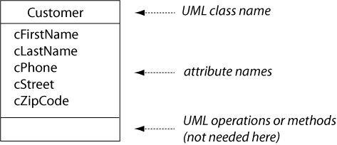
Basic Structures: Classes and Schemes – Class Diagram
A class diagram shows the class name and list of attributes that identify data elements we need to know about each member (instance, occurrence, of a class)
The Customer class represents any person who has done business with us or who we think might do business with us in the future. Its attributes are:
  Customer first name.
  Customer last name.
  Customer phone.
  Customer street.
  Customer zip code.

Slide 19
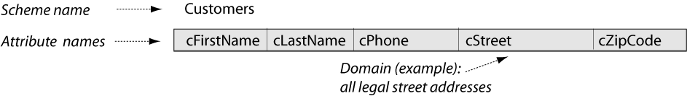
Basic Structures: Classes and Schemes – Relation Scheme
In an OO programming language, each class is instantiated with objects of that class. In building a relational database, each class is first translated into a relation model scheme. The scheme starts with all of the attributes from the class diagram.
The Customers relation scheme attributes are:
  Customer first name, a person's first name.
  Customer last name, a person's last name.
  Customer phone, a valid telephone number.
  Customer street, a street address.
  Customer zip code, a zip code designated by the United States Postal Service.

Slide 20
Basic Structures: Classes and Schemes – Sets
In the relational model, a scheme is defined as a set of attributes, together with an assignment rule that associates each attribute with a set of legal values that may be assigned to it. These values are called the domain of the attribute.
  Customers Scheme = {cFirstname, cLastname, cPhone, cStreet, cZipCode}.
It’s important to recognize that defining schemes or domains as sets of something automatically tells us a lot more about them:
  They cannot contain duplicate elements.
  The elements in them are unordered.
  We can develop rules for what can be included in them and what is excluded from them. For example, zip codes don’t belong in the domain (set) of phone numbers, and vice-versa.
  We can define subsets of them—for example, we can display only a selected set of attributes from a scheme, or we can limit the domain of an attribute to a specific range of values.
  They may be manipulated with the usual set operators (union, intersection).

Slide 21
Basic Structures: Classes and Schemes – Table Structure
When we actually build the database, each relation scheme becomes the structure of one table.
CREATE TABLE customers (
cfirstname VARCHAR(20) NOT NULL, clastname VARCHAR(20) NOT NULL, cphone VARCHAR(20) NOT NULL,
cstreet VARCHAR(50),
czipcode VARCHAR(5));

Slide 22
Basic Structures: Classes and Schemes – Data Models
Conceptual
Logical
Physical

Slide 23
Exercise: Designing Classes
Design classes to represent the following "things" in the given enterprises. For each one, describe the class in English, then draw the class diagram.
  A student at a university.
  A faculty member at a university.
  A work of art that is displayed in a gallery or museum.
  An automobile that is registered with the Motor Vehicle Department.
  A pizza that is on the menu at a restaurant.
The solution to this exercise will be discussed in class

Slide 24
Exercise: More Designing Classes
Design classes to represent the any three different enterprises that you find.
  For each one, describe the class in English, then draw the class diagram.
We’ll discuss your examples in class.

Slide 25
Basic Structures: Rows and Tables - Definitions
Each real-world individual of a class is represented by a row of information in a database table.
The row is defined in the relational model as a tuple that is constructed over a given scheme.
Mathematically, the tuple is a function that assigns a constant value from the attribute domain to each attribute of the scheme. Since the scheme is really a set of attributes, order is not important.

Slide 26
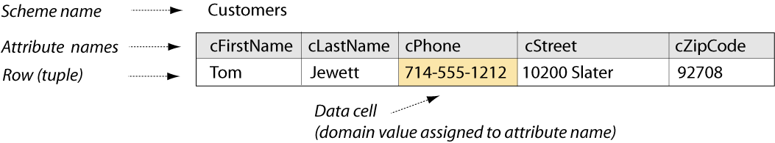
Basic structures: Rows and Tables – Assignment
Each attribute of the Customers scheme is assigned a value from its domain:
  Customer first name is assigned the value "Tom", from the domain of people's first names.
  Customer last name is assigned the value "Jewett", from the domain of people's last names.
  Customer phone is assigned the value "714-555-1212", from the domain valid telephone numbers.
  Customer street is assigned the value "10200 Slater", from the domain of street addresses.
  Customer zip code is assigned the value "92708", from the domain of zip codes designated by the United States Postal Service.
Each of the assignments results in a data cell of the row or tuple.

Slide 27
Basic Structures: Rows and Tables – Formal Notation
In formal notation, we could show the assignments explicitly, where t represents a tuple:
tTJ = ‹cfirstname := 'Tom', clastname := 'Jewett', cphone := '714-555-1212', cstreet := '10200 Slater', czipcode := '92708'›
Database:
INSERT INTO customers (cfirstname, clastname, cphone, cstreet, czipcode) VALUES ('Tom', 'Jewett', '714-555-1212', '10200 Slater', '92708');
UPDATE customers SET cphone = '714-555-2323' WHERE cphone = '714-555-1212';

Slide 28
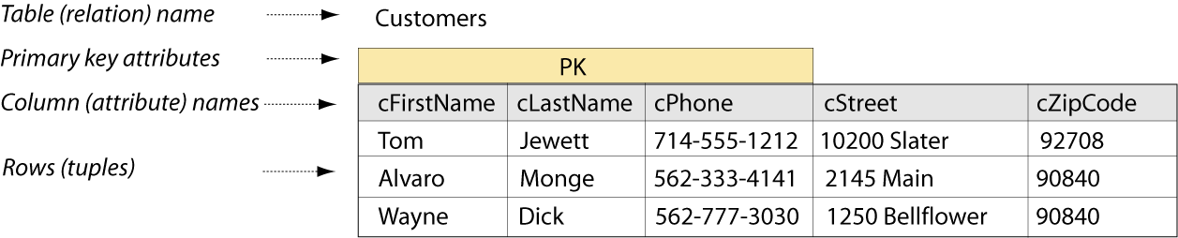
Basic Structures: Rows and Tables - Database
A database table is simply a collection of zero or more rows. This follows from the relational model definition of a relation as a set of tuples over the same scheme. Order is not important.
Additional rows are built on the Customers scheme as before. The table or relation consists of all rows.
Three of the attributes in the Customers scheme are now identified as the primary key, which is explained later on.

Slide 29
Basic Structures: Rows and Tables - Tuples
Knowing that the relation (table) is a set of tuples (rows) tells us more about this structure, as we saw with schemes and domains.
  Each tuple/row is unique; there are no duplicates
  Tuples/rows are unordered; we can display them in any way we like and the meaning doesn’t change. (SQL gives us the capability to control the display order.)
  Tuples/rows may be included in a relation/table set if they are constructed on the scheme of that relation; they are excluded otherwise. (It would make no sense to have an Order row in the Customers table.)
  We can define subsets of the rows by specifying criteria for inclusion in the subset. (Again, this is part of a SQL query.)
  We can find the union, intersection, or difference of the rows in two or more tables, as long as they are constructed over the same scheme.

Slide 30
Basic Structures: Rows and Tables – Insuring Unique Rows
Each row in a table must be distinct. So there must be a set of attributes in each relation that guarantee uniqueness. Any set of attributes that can do this is called a super key of the relation.
The database designer picks of the possible super key sets to serve as the primary key or unique identifier of each row.

Slide 31
Basic Structures: Rows and Tables – Super Keys
cfirstname,clastname,cphone,cstreet,czipcode
cfirstname,clastname,cphone,cstreet
cfirstname,clastname,cphone,czipcode
cfirstname,clastname,cstreet,czipcode
cfirstname,clastname,cphone,
cfirstname,clastname,cstreet

Slide 32
Basic Structures: Rows and Tables – Insuring Unique Rows - SQL
ALTER TABLE customers
ADD CONSTRAINT customers_pk
PRIMARY KEY (cfirstname, clastname, cphone);
CREATE TABLE customers (
cfirstname VARCHAR(20) NOT NULL,
clastname VARCHAR(20) NOT NULL,
cphone VARCHAR(20) NOT NULL,
cstreet VARCHAR(50),
czipcode VARCHAR(5)),
CONSTRAINT customers_pk
PRIMARY KEY (cfirstname, clastname, cphone);

Slide 33
Basic Structures: Associations – The UML Association
UML association (ER term: relationship) is the way that two classes are functionally connected to each other.
Example: relationship between customers and orders in a sales database. First define orders then define the relationship.
UML multiplicity (ER term: cardinality) how few (at minimum) and how many (at maximum) individuals of one class may be connected to a single individual of the other class.

Slide 34
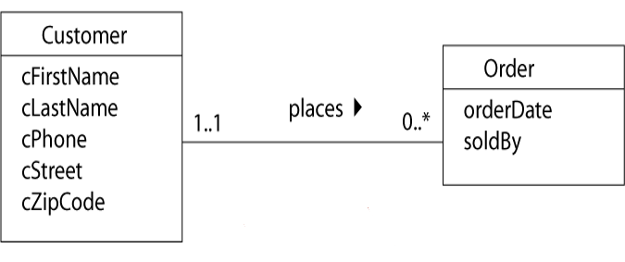
Basic structures: Associations – Class Diagram
One customer places zero to many orders
One order is placed by one and only one customer

Slide 35
Basic structures: Associations – Class Diagram Data Dictionary
The Customer class represents any person who has done business with us or who we think might do business with us in the future. Its attributes are:
  Customer first name.
  Customer last name.
  Customer phone.
  Customer street.
  Customer zip code.
The Order class represents an event that happens when a customer decides to buy one or more of our products. Its attributes are:
  Order date.
  Sold by, which identifies the sales person.
The association between customer and order classes is:
  Each customer places zero or more orders.
  Each order is placed by one and only one customer.

Slide 36
Basic Structures: Associations – Class Diagram Description
Looking at the maximum multiplicity at each end of the line (1 and * here), we call this a one-to-many association.
The UML representation of the Order class contains only its own descriptive attributes. The UML association tells which customer placed an order.
In the database, we will need a different way to identify the customer; that will be part of the relation scheme.

Slide 37
Basic Structures: Associations – Relation Scheme
The relation scheme for the new Orders table contains all of the attributes from the class diagram as before. But we also need to represent the association in the database – which customer placed each order. This is done by copying the PK attributes of the Customer into the Orders scheme.
The copied attributes are called a foreign key.

Slide 38
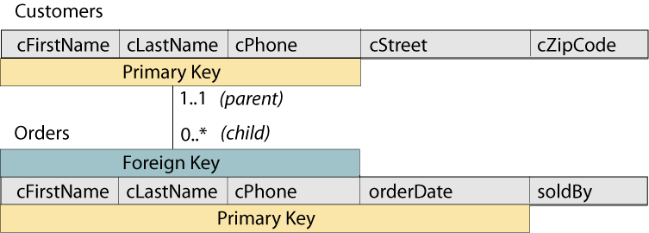
Basic Structures: Associations – Relation Scheme Diagram

Slide 39
Basic structures: Associations – Relation Scheme Data Dictionary
The Customers relation scheme attributes are:
  Customer first name, a person's first name.
  Customer last name, a person's last name.
  Customer phone, a valid telephone number.
  Customer street, a street address.
  Customer zip code, a zip code designated by the United States Postal Service.
The primary key attributes of the Customers relation are the first name, last name, and phone.
The Orders relation scheme attributes are:
  Customer first name, foreign key from Customers.
  Customer last name, foreign key from Customers.
  Customer phone, foreign key from Customers.
  Order date, a calendar date possibly with the clock time.
  Sold by, the first name of the sales person taking the order.
The primary key attributes of the Orders relation are the three foreign key attributes plus the order date.

Slide 40
Basic Structures: Associations – Relation Scheme Description
Since we can’t have an order without a customer, we call Customers the parent and Orders the child scheme in this association.
The “one” side of an association is always the parent, and provides the PK attributes to be copied.
The “many” side of an association is always the child, into which the FK attributes are copied.
Memorize it: one, parent, PK; many, child, FK.
An FK might or might not become part of the PK of the child relation into which it is copied. In this case, it does, since we need to know both who placed an order and when the order was placed in order to identify it uniquely.

Slide 41
Basic Structures: Associations – The Child Table
CREATE TABLE orders (
cfirstname VARCHAR(20),
clastname VARCHAR(20),
cphone VARCHAR(20),
orderdate DATE,
soldby VARCHAR(20));
The FK attributes must be exactly the same data type and size as in the PK table
In some DBMS, DATE is both Date and Time

Slide 42
Basic Structures: Associations – Uniqueness
To insure that every row of the Orders table is unique, we need to know both who the customer is and what day (and time) the order was placed.
We specify all of these attributes as the pk:
ALTER TABLE orders
ADD CONSTRAINT orders_pk
PRIMARY KEY (cfirstname, clastname, cphone, orderdate);

Slide 43
Basic Structures: Associations –Referential Integrity
In addition, we need to identify which attributes make up the FK, and where they are found as a PK. The FK constraint will insure that every order contains a valid customer name and phone number—this is called maintaining the referential integrity of the database.
ALTER TABLE orders
ADD CONSTRAINT orders_customers_fk
FOREIGN KEY(cfirstname, clastname, cphone)
REFERENCES customers (cfirstname, clastname, cphone);

Slide 44
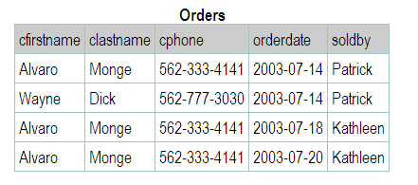
Basic Structures: Associations – The Orders Table

Slide 45
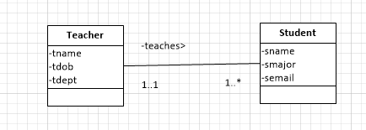
Another Example
Let’s limit this enterprise to consider the relationship between a University instructor and the students in one class

Slide 46
Class Definitions
A teacher is a person that instructs students taking courses to learn.
A student is someone enrolled in classes to receive an education.

Slide 47
Relationship Definitions
One teacher teaches one to many students.
One student is taught by one and only one teacher.

Slide 48
Primary Key
For the primary key of Teacher, use tname and tdob.
Copy these PK attributes from the parent (Teacher) to the child (Student) and mark them as Foreign Keys.
Question: does a Student need a Teacher to be unique? No, the email itself can be used as the PK of the student.
This is an example of when the FK of the parent is NOT part of the FK of a child.

Slide 49
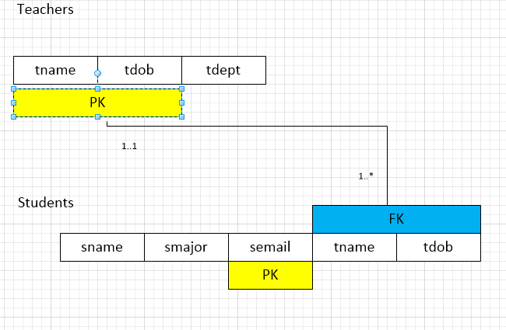
Relation Scheme

Slide 50
SQL
Even though in this example, the FK of the parent does not become part of the PK of the child, the Students table still needs to have the FK attributes as part of the table and a FK constraint must still be created.

Slide 51
CREATE TABLE teachers (
tname VARCHAR(20) NOT NULL,
tdept VARCHAR(20) NOT NULL,
tdob DATE NOT NULL);
ALTER TABLE teachers
ADD CONSTRAINT teachers_pk
PRIMARY KEY (tname, tdept, tdob);

Slide 52
Students Table
CREATE TABLE students (
tname VARCHAR(20) NOT NULL,
tdept VARCHAR(20) NOT NULL,
sname VARCHAR(20) NOT NULL,
smajor VARCHAR(20) NOT NULL,
semail VARCHAR(90) NOT NULL);
ALTER TABLE students
ADD CONSTRAINT students_pk
PRIMARY KEY (semail);
ALTER TABLE students
ADD CONSTRAINT students_teachers_fk
FOREIGN KEY (tname,tdob)
REFERENCES teachers (tname,tdob);

Slide 53
Exercise: Patients and Blood Samples
The one-to-many association is perhaps the most common one that you will encounter in database modeling. As an example, we will look at the enterprise of a medical clinic.
We wish to track the level of various substances (for example, cholesterol or alcohol) in the blood of patients. For each blood sample that is taken from the patient, one test will be performed and the date of the sample, the substance tested, and the measured level of that substance will be recorded in a database.
  Describe each class in English.
  Draw the class diagram.
  Describe each association in English (both directions).
  Draw the relation scheme.
The solution to this exercise will be discussed in class

Slide 54
Exercise: Cities and States
Part of a database that you are developing will contain information about cities and states in the United States. Each city is located in only one state. (Texarkana, Texas is a different city than Texarkana, Arkansas.)
  Describe each class in English.
  Draw the class diagram.
  Describe each association in English (both directions).
  Draw the relation scheme.
The solution to this exercise will be discussed in class

Slide 55
Exercise: Library Books
You are building a very simplified beginning of the database for a library.
The library, of course, owns (physical) books that are stored on shelves and checked out by customers. Each of these books is represented by a catalog entry (now in the computer, but think of an old-fashioned card file as a model of this).
Assume that there is only one title card for each book in the catalog, but there can be many physical copies of that book on the shelves.
Call the title card class a CatalogEntry and the physical book class a BookOnShelf.

Slide 56
Exercise: Library Books
You might think of the book's publisher as a simple attribute of the catalog entry but in fact, the library will probably want to know more than just the publisher's name (for example, the phone number where they can contact a sales representative).
  Describe each class in English.
  Draw the class diagram.
  Describe each association in English (both directions).
  Draw the relation scheme.
The solution to this exercise will be discussed in class

Slide 57
Discussion: More About Keys

Slide 58
Discussion: More About Keys – Super Key
Remember that a super key is any set of attributes whose values, taken together, uniquely identify each row of a table—and that a primary key is the specific super key set of attributes that we picked to serve as the unique identifier for rows of this table.
We are showing these attributes in the scheme diagram for convenience, understanding that keys are a property of the table (relation), not of the scheme.

Slide 59
Discussion: More About Keys – Candidate Keys
Before picking the PK, we need to identify any candidate key or keys that we can find for the table. A CK is a minimal super key. Minimal means that if you take away any one attribute from the set, it is no longer a super key.
If you add one attribute to the set, it is no longer minimal but it’s still a super key. The word “candidate” simply means that this set of attributes could be used as the primary key.
Whether a set of attributes constitutes a CK or not depends entirely on the data in the table – not just on whatever data happens to be in the table at that moment but on any set of data that could be realistically be in the table over the life of the database.
Does the set {cFirstName,cLastName,cPhone} meets the test. If not, what other attributes might we need in the table to make a candidate key?

Slide 60
Discussion: More About Keys – PK Size Might Matter
Copying three attributes from the parent table to the child table each time a child record is created can be a lot of data even if we have a valid candidate key. It may make sense to “make up” a PK that is small enough. There are two types of “made up” PKs:
surrogate PK – a single, small attribute (such as a number) that has no descriptive value such as an id number
substitute PK – a single, small attribute (such as an abbreviation) that has at least some descriptive value.

Slide 61
Discussion: More About Keys – Surrogate/Substitute Keys
Do not automatically add surrogate or substitute keys to a table until you are sure that
  there is at least one candidate key before the surrogate is added
  the table is a parent in at least one association
  there is no candidate key small enough for its values to be copied many times into the child table
external key – a surrogate or substitute key already defined by someone else such as a zip code, UPC, ISBN
Only use a Social Security Number as a NON-KEY field if required by law

Slide 62
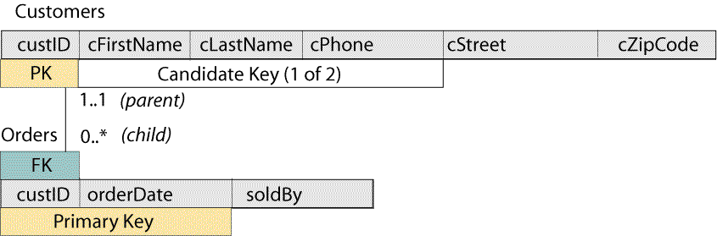
Discussion: More About Keys – Revising the Relation Scheme

Slide 63
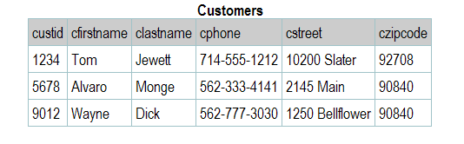
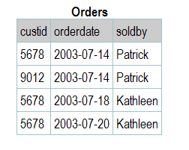
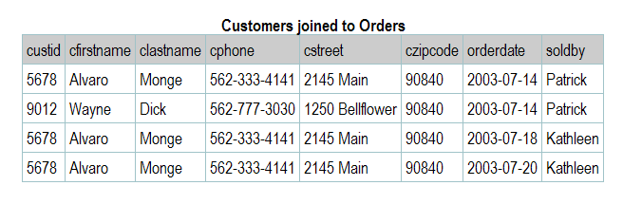
Discussion: More About Keys –Customer Joined to Orders

Slide 64
Design Pattern: Many-to-Many (Order Entry)
Design patterns are modeling situations that you will find over and over again as you design real databases. These become tools that you use constantly use to build enterprise models.
The sales database represents one of these design patterns called “many-to-many.” In order to complete the pattern we need products to sell.

Slide 65
Design Pattern: Many-to-Many (Order Entry)–Finishing the Pattern
Define the product
Define the relationship between orders and products
Define the need for orderlines
Since the maximum multiplicity in each direction is “many,” this is called a many-to-many association between Orders and Products.
Each time an order is placed for a product, we need to know how many units of that product are being ordered and what price we are actually selling the product for. These attributes are a result of the association between the Order and the Product. We show them in an association class that is connected to the association by a dotted line.

Slide 66
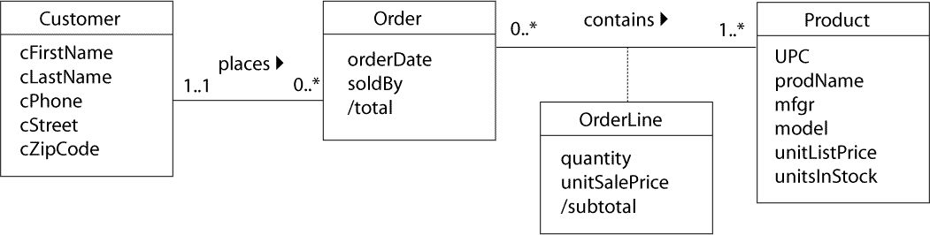
Design Pattern: Many-to-Many (Order Entry) – Class Diagram

Slide 67
Design Pattern: Many-to-Many (Order Entry) – Junction Table
We can’t represent a many-to-many association directly in a relation scheme, because two tables can’t be children of each other—there’s no place to put the foreign keys. So for every many-to-many, we will need a junction table in the database, and we need to show the scheme of this table in our diagram.

Slide 68
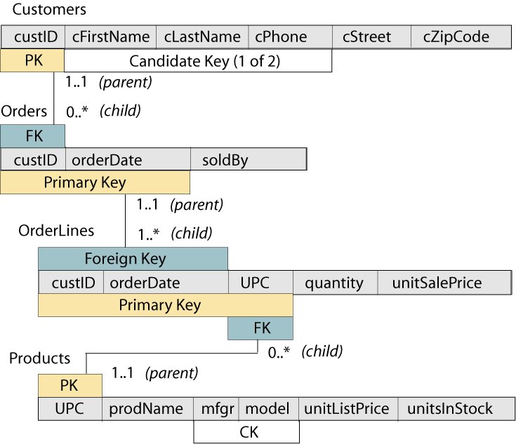
Design Pattern: Many-to-Many (Order Entry) – Relation Scheme

Slide 69
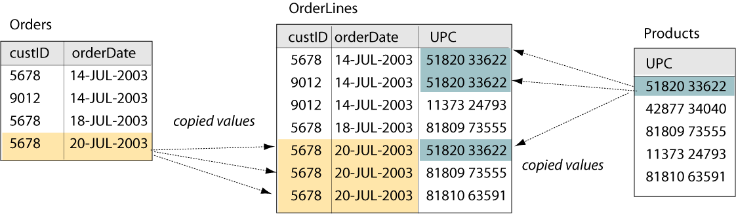
Design Pattern: Many-to-Many (Order Entry) – Data Representation

Slide 70
Exercise: Building a Database With Notecards
Exercise

Slide 71
Exercise: Students and Classes
If you are using this Web site in a class at a university, you are probably interested in what grade you will get in the class.
You will need to model the students and the (university) classes, their attributes, and the relationship between them. Be sure to show where the grade should be recorded.
  Describe each class in English.
  Draw the class diagram, including association classes if required.
  Describe each association in English (both directions).
  Draw the relation scheme.
The solution to this exercise will be discussed in class

Slide 72
Exercise: Book Authors
Refer back to the library book exercise in the preceeding section if necessary. Remember that we couldn't include authors in the CatalogEntry class because there might be more than one author for each book.
In a real (old-fashioned) library catalog, there was an additional card for each author of a book. (Author and title cards were contained in different sets of card drawers.)

Slide 73
Exercise: Book Authors
Design a class diagram that shows the catalog entry plus authors, the attributes of each class, and the association between the classes.
  Describe each class in English.
  Draw the class diagram.
  Describe each association in English (both directions).
  Draw the relation scheme.
Your first version of this model might not have included a way to identify which author should be listed first, second, and so on. In real life, authors are very sensitive about this. Revise your model if necessary to accommodate this requirement.
The solution to this exercise will be discussed in class

Slide 74
Exercise: Auto Repair
You are designing a database for an automobile repair shop. When a customer brings in a vehicle, a service advisor will write up a repair order. This order will identify the customer and the vehicle, along with the date of service and the name of the advisor.
A vehicle might need several different types of service in a single visit. These could include oil change, lubrication, rotate tires, and so on.
Each type of service is billed at a pre-determined number of hours work, regardless of the actual time spent by the technician.
Each type of service also has a flat book rate of dollars-per-hour that is charged.

Slide 75
Exercise: Auto Repair
  Describe each class in English.
  Draw the class diagram, including association classes if required.
  Describe each association in English (both directions).
  Draw the relation scheme.
The solution to this exercise will be discussed in class

Slide 76
Exercise: Redbox
You are designing a database for a DVD Rental Kiosk. To start, you need the part of the system that will allow a customer to check out a group of dvds and receive an invoice that lists them along with the cost and the date they are due.
  Describe each class in English.
  Draw the class diagram, including association classes if required.
  Describe each association in English (both directions).
  Draw the relation scheme.

Slide 77
Exercise: Santa’s List
You are designing a database to help Santa Claus and his elves to keep track of the toys he gives to children.
He obviously needs to know the name and address of each child on his list, and when they were born.
Every year, each child will give Santa a list of the toys that he/she wants.
Santa will record whether that child has been naughty or nice that year, then pick which toys to actually deliver.
A child won't get more than one of each toy, probably won't get everything that he/she asked for, and might get something that wasn't asked for (like a lump of coal if he's been naughty).
Of course, Santa doesn't want to give a child any of the same toys this year as he gave them last year.

Slide 78
Exercise: Santa’s List
Hint: the solution is much easier than you might think the first time you read through this exercise.
  Describe each class in English.
  Draw the class diagram, including association classes if required.
  Describe each association in English (both directions).
  Draw the relation scheme.
The solution to this exercise will be discussed in class

Slide 79
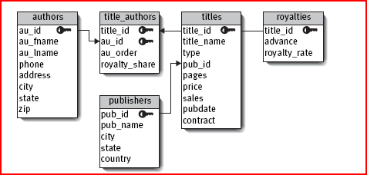
Exercise: Books Relation Scheme
Look at the class diagram for the Books Database in the SQL-QS book (3/e pg 51).
  Draw the relation scheme.
The solution to this exercise will be discussed in class

Slide 80
Design Pattern: Many-to-Many With History (the Library Loan)
There are times when we need to allow the same two individuals in a many-to-many association to be paired more than once. This frequently happens when we need to keep a history of events over time.
Example: In a library, customers can borrow many books and each book can be borrowed by many customers, so this seems to be a simple many-to-many association between customers and books. But any one customer may borrow a book, return it, and then borrow the same book again at a later time. The library records each book loan separately; there is no invoice for each set of borrowed books (that is, there is no equivalent here of the Order in the order entry example).

Slide 81
Design Pattern: Many-to-Many With History (the Library Loan) – Classes
The loan is an event that happens in the real world. We need a regular class to model it correctly. We’ll call this the “library loan” design pattern. First, we need to understand what the classes and associations mean:
“A customer is any person who has registered with the library and is eligible to check out books.”
“A catalog entry is essentially the same as an old-fashioned index card that represents the title and other information about books in the library, and allows the customers to quickly find a book on the shelves.”
“A book is the physical volume that is either sitting on the library shelves or is checked out by a customer. There can be many physical books represented by any one catalog entry.”
“A loan event happens when one customer takes one book to the checkout counter, has the book and her library card scanned, and then takes the book home to read.”

Slide 82
Design Pattern: Many-to-Many With History (the Library Loan)-Associations
“Each Customer makes zero or more Loans.”
“Each Loan is made by one and only one Customer.”
“Each Loan checks out one and only one Book.”
“Each Book is checked out by zero or more Loans.”
“Each Book is represented by one and only one CatalogEntry (catalog card).”
“Each CatalogEntry can represent one or more physical copies of the same book.”

Slide 83
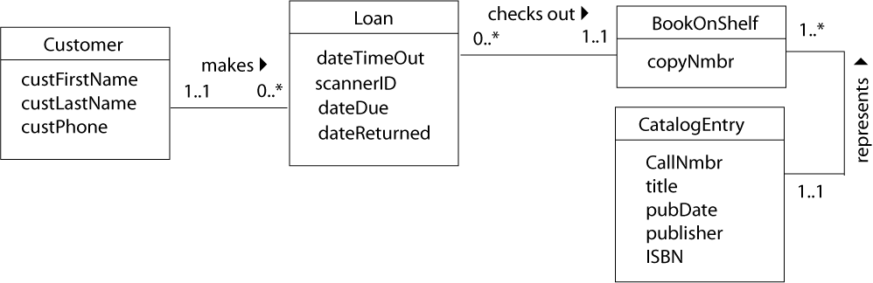
Design Pattern: Many-to-Many With History(Library Loan)–Class Diagram

Slide 84
Design Pattern: Many-to-Many With History (Library Loan)–Keys
As in the order entry example, the Customers table will need a surrogate key to save space when it is copied in the Loans.
The CatalogEntry already has two external surrogate keys: the call number and the ISBN.
  The first of these is defined by the Library of Congress Classification system, and contains codes that represent the subject, author, and year published.
  The second of these is defined by a standard, number 2108. We’ll use the callNmbr as the primary key, since it has more descriptive value than the ISBN and is smaller than the descriptive candidate key:
    CK {title, pubDate}
The dateTimeOut is needed as part of the key in the Loans table in order to pair a customer with the same book more than once.

Slide 85
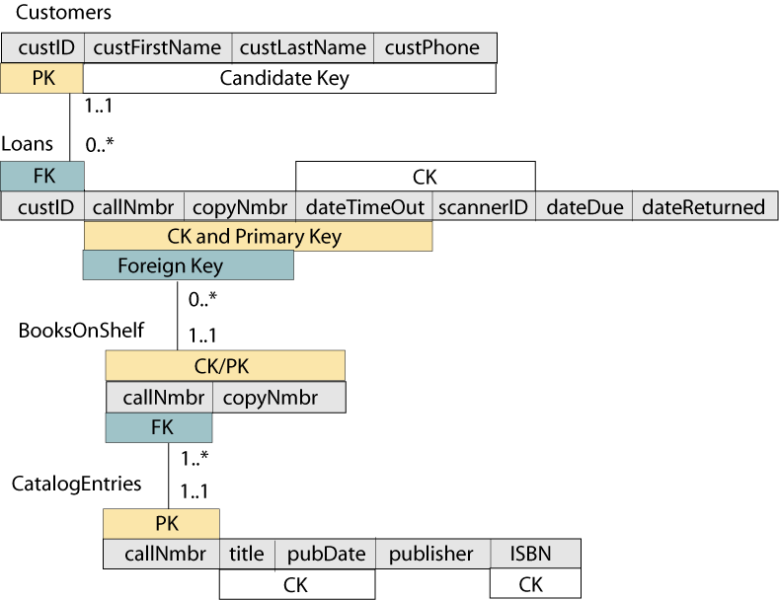
Design Pattern: Many-to-Many With History (Library Loan)–Diagram

Slide 86
Design Pattern: Many-to-Many With History (Library Loan)
As we would do in a junction table scheme, we’ll copy the primary key attributes from both the Customers and the BooksOnShelf into the Loans scheme. This tells us which customer borrowed which book, but it doesn't tell when it was borrowed. We have to know the dateTimeOut in order to pair a customer with the same book more than once.
We can call this a discriminator attribute, since it allows us to discriminate between the multiple pairings of customer and book. If you refer back to the UML class diagram, you’ll see that the loan, which would have been a many-to-many association class between customers and books, has become a “real” class because of the discriminator attribute.
Notice that there is actually another CK for the loan:
  {dateTimeOut, scannerID}
  since it is also physically impossible for the same scanner to read two different
  books at exactly the same time.
We chose {callNmbr, copyNmbr, dateTimeOut} because it has just a bit more descriptive value and because we don’t care about size here (since the Loan has no children).

Slide 87
Exercise: Employee Timecards
In many businesses, employees may work on a number of different projects.
Each week, they will submit a time card that lists each project on a separate line, along with the number of hours that they have worked that week on that project.
  Describe each class in English.
  Draw the class diagram, including association classes if required.
  Describe each association in English (both directions).
  Draw the relation scheme.
The solution to this exercise will be discussed in class

Slide 88
Exercise: More Many-to-Many
Model any three many-to-many (without history) relationships that you find. You will need to model the classes, their attributes, and the relationship between them.
  Describe each class in English.
  Draw the class diagram, including association classes if required.
  Describe each association in English (both directions).
  Draw the relation scheme.
We’ll discuss your examples in class.

Slide 89
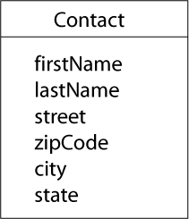
Design Pattern: Subkeys (the Zipcode)
One of the major goals of relational database design is to prevent unnecessary duplication of data.
The Contact class represents any person who is a business associate, friend, or family member. Its attributes are:
  Contact first name.
  Contact last name.
  Contact street.
  Contact zip code.
  Contact city.
  Contact state.

Slide 90
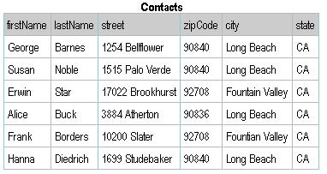
Design Pattern: Subkeys (the Zipcode) - Problem
It may not be obvious that the model has a problem until you look at the data

Slide 91
Design Pattern: Subkeys (the Zipcode) – Functional Dependency
functional dependency is simply a more formal term for the super key property. If X and Y are sets of attributes, then the notation X→Y is read “X functionally determines Y” or “Y is functionally dependent on X.” This means that if I’m given a table filled with data plus the value of the attributes in X, then I can uniquely determine the value of the attributes in Y.
A super key always functionally determines all of the other attributes in a relation (as well as itself). This is a “good” FD. A “bad” FD happens when we have an attribute or set of attributes that are a super key for some of the other attributes in the relation, but not a super key for the entire relation. We call this set of attributes a subkey of the relation.

Slide 92
Design Pattern: Subkeys (the Zipcode) – Functional Dependency (con’t).
A subkey dependency enables us to detect when a relation scheme has redundancy -- when a table using the scheme will contain unnecessary duplication of information.
A relation scheme has redundancy whenever there is a subkey dependency.

Slide 93
Design Pattern: Subkeys (the Zipcode) – Preventing/Removing Redundancy
There is a very simple way to fix the problem with a relation scheme that has redundancy, as detected by the presence of a subkey.
In the steps given below, the scheme with redundancy is R and the subkey is represented by the FD W→Z, where each of W and Z is a set of attributes that is a subset of the attributes in R.

Slide 94
Design Pattern: Subkeys (the Zipcode) – Preventing/Removing Redundancy(con’t).
Replace R by two schema, R₁ and R₂ as described in the following steps.
Assign R₁ the attributes in the union of the attributes in the subkey FD. That is R₁={W ∪ Z}. Since W→Z, by definition, W is a superkey of R₁.
Assign R₂ the set of attributes {R - Z}, that is, all the attributes in R except those in Z, the attributes on the right-hand-side of the subkey FD
Both R₁ and R₂ share W in common. In R₁, W is a superkey and in R₂ it becomes a foreign key.

Slide 95
Design Pattern: Subkeys (the Zipcode) – Preventing/Removing Redundancy(con’t).
The “bad” subkey dependency has been removed because we’ve moved the attributes that were functionally dependent on W to another scheme, and we’ve made W the super key of that scheme.

Slide 96
Design Pattern: Subkeys (the Zipcode) - Solution
In other words:
Remove all of the attributes that are dependent on the subkey. Put them into a new scheme.
Duplicate the subkey attribute set in the new scheme, where it becomes the primary key of the new scheme.
Leave a copy of the subkey attribute set in the original scheme, where it is now a foreign key. It is no longer a subkey, because you’ve gotten rid of the attributes that were functionally dependent on it, and you’ve made it the primary key of its own table. The revised model will have a many-to-one relationship between the original scheme and the new one.

Slide 97
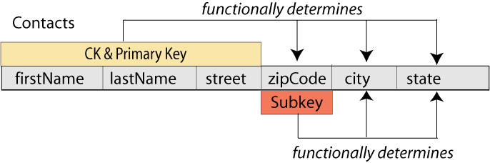
Design Pattern: Subkeys (the Zipcode) - Subkey
In the Contacts table, the zipCode is a subkey. It functionally determines the city and state. The opposite is not true, because many cities have more than one zip code.

Slide 98
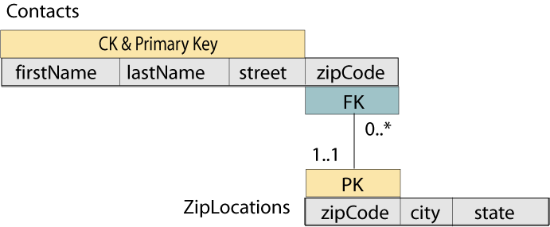
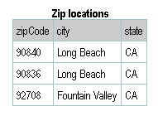
Design Pattern: Subkeys (the Zipcode) – Lossless Join Decomposition
Moving the data to a new table and then joining the two tables is called lossless join decomposition of the original table

Slide 99
Design Pattern: Subkeys (the Zipcode) - Normalization
Normalization means following a procedure or set of rules to insure that a database is well designed. Most normalization rules are meant to eliminate redundant data (that is, unnecessary duplicate data) in the database.
Subkeys always result in redundant data, so we need to eliminate them. If there are no subkeys in any of the tables in your database, you have a well-designed model according to what is usually called third normal form, or 3NF.
Edgar F. Codd was a mathematician and computer scientist who laid the theoretical foundation for relational databases.
“The key, the whole key and nothing but the key so help me Codd”

Slide 100
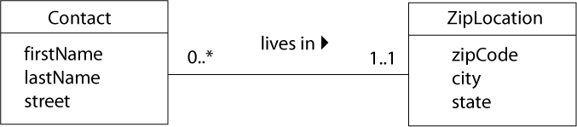
Design Pattern: Subkeys (the Zipcode) – Class Diagram
When we find a subkey in a relation scheme or table, we also know that the original UML class was badly designed. The problem, always, is that we have actually placed two conceptually different classes in a single class definition.
In this example, a zipCode is not just an attribute of the Contact class. It is part of a ZipLocation class, which we can describe as “a geographical location whose boundaries have been uniquely identified by the U.S Postal Service for mail delivery.”
As with all one-to-many associations, the association itself identifies which Contact lives in which ZipLocation. If we had started with this class diagram, we would have produced exactly the same relation scheme that we developed with the normalization process above!

Slide 101
Exercise: Plant Species
You are working on a database for a company that grows and sells plants.
One important table contains a list of the plant species that they grow, which are identified botanically by their genus and specie name, family, and common name.
Even if you have never heard of these terms, you can analyze the table by looking at the data given below:

Slide 102
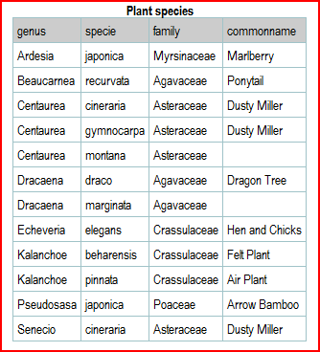
Exercise: Plant Species

Slide 103
Exercise: Plant Species
Draw the relation scheme for this table as it is shown above. Identify the primary key.
Draw the relation scheme for a lossless join decomposition of this table.

Slide 104
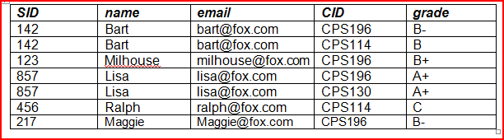
Exercise: Student Grades
You are working an on application to store student data for the CECS department. Based on the data in the following table:
  Draw the relation scheme for this table as it is shown above. Identify the primary key.
  Draw the relation scheme for a lossless join decomposition of this table.

Slide 105
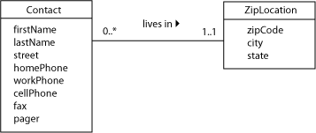
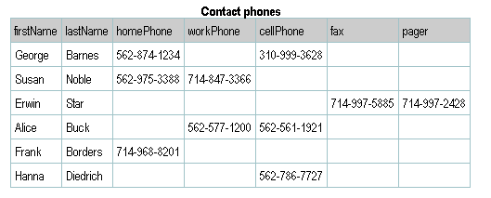
Design Pattern: Repeated Attributes (the Phone Book)
The contact manager example from our preceding discussion of subkeys is also an excellent illustration of another problem that is found in many database designs.

Slide 106
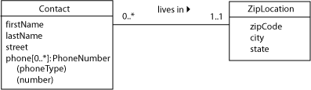
Design Pattern: Repeated Attributes (the Phone Book) – Weak Entity
Note the large amount of null values and the inability of the model to keep up with changing times. Notice that the phone numbers are actually repeated attributes. It is essentially a class within a class.
This can be called a weak entity since it can’t exist without the parent entity type.

Slide 107
Design Pattern: Repeated Attributes (the Phone Book) - Fix
In order to fix this problem we need to create a new table:
Remove all of the phone number fields from the Contacts relation. Create a new scheme that has the attributes of the phone number structure (phone type and number).
The Contacts relation has now become a parent so we add a surrogate key and copy it into the new scheme. There is now a one-to-many relationship between Contacts and PhoneNumbers.
To identify each phone number, we need to know at least who it belongs to and what type it is. However, a person can have two cell phones so all three attributes are needed for the PK. Since this is not a parent relation, the PK size doesn’t matter.

Slide 108
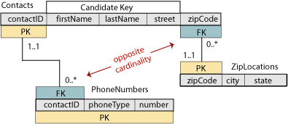
Design Pattern: Repeated Attributes (the Phone Book) - Relation Scheme

Slide 109
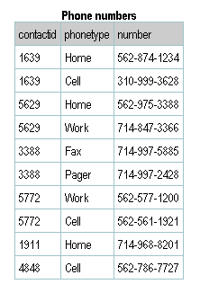
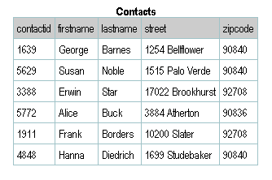
Design Pattern: Repeated Attributes (the Phone Book) – Tables

Slide 110
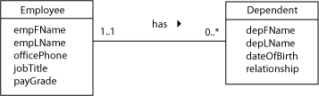
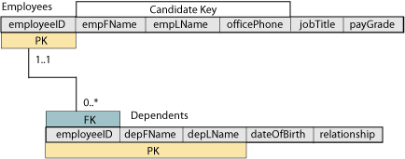
Design Pattern: Repeated Attributes (the Phone Book) - Employees
The modeling technique shown above is useful where the parent class has relatively few attributes and the repeated attribute has only one or a very few attributes of its own. However, you can also model the repeated attribute as a separate class in the UML diagram. One classic textbook example is an employee database.

Slide 111
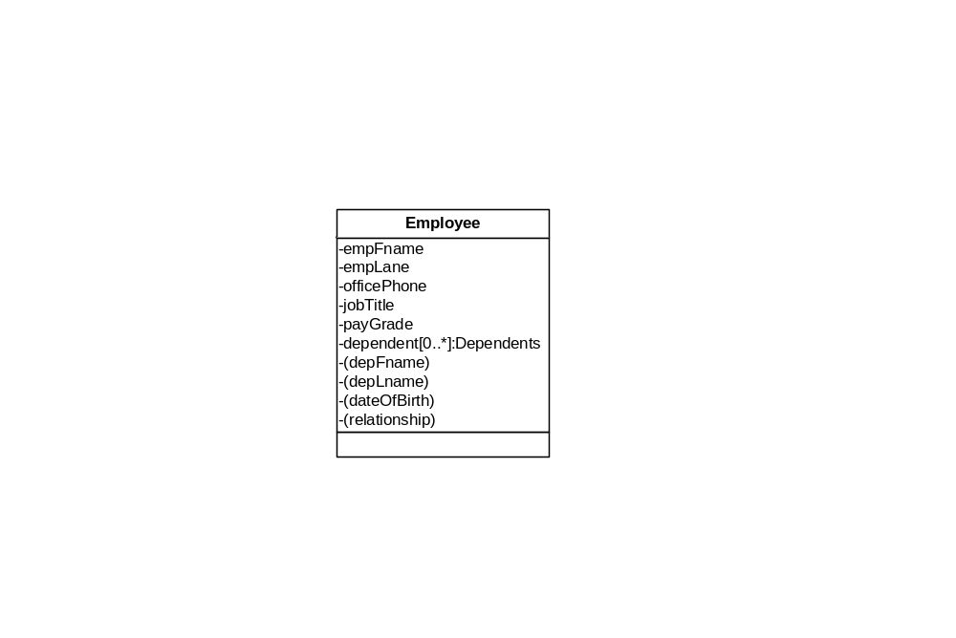
Design Pattern: Repeated Attributes (the Phone Book) – Employees (cont)
This is the same example using the “shorthand” notation.

Slide 112
Exercise: Monthly Publication Usage
A large task for computer manufacturers is to keep track of their publications: product specification sheets, marketing brochures, user manuals, and so on.
One major manufacturer had developed a spreadsheet to record the monthly usage of each publication (that is, how many copies of the publication were distributed each month).
Then they decided to export the spreadsheet into a database.
The export program naturally converted each column of the spreadsheet into a database table attribute, so the result looked something like this:

Slide 113
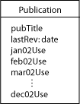
Exercise: Monthly Publication Usage
Revise the class diagram to correct any problems that you find in this design.
Then draw the relation scheme for your corrected model.

Slide 114
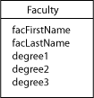
Exercise: Faculty Degrees
A number of years ago, I taught evening courses at a small college extension center. The center staff kept a list of faculty members in one of the very early PC-based database programs. There was only one faculty table, part of which looked like this:
No, I'm not making this up. There really were three fields to hold information about degrees that instructors had earned. The data in each degree field looked something like: MS in Computer Science, 1980, UC Santa Barbara.

Slide 115
Exercise: Faculty Degrees
Revise the class diagram to correct any problems that you find in this design.
Then draw the relation scheme for your corrected model.

Slide 116
Design Pattern: Multi-Valued Attributes (Hobbies)
When there are many distinct values entered in the same column of the table we have another design problem called multi-valued attributes .
This makes it difficult to search the table for any one particular value and it is impossible to create a query that will individual list the values in that column. For example: hobbies.

Slide 117
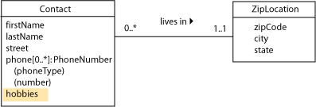
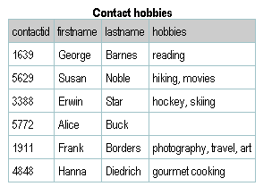
Design Pattern: Multi-Valued Attributes (Hobbies) – Class Diagram

Slide 118
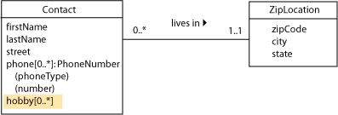
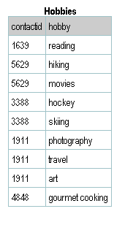
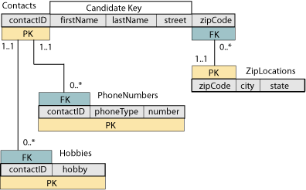
Design Pattern: Multi-Valued Attributes (Hobbies) - Corrected

Slide 119

Exercise: Software List
Sometimes it takes more than just a glance at the class diagram to spot problems with a design.
Consider the following class type that might be used by a software vendor to list software titles that are available.

Slide 120
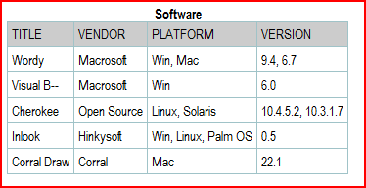
Exercise: Software List
There is nothing obviously wrong with this design. However, the users of this database might enter data that would cause problems, as shown in this table:
Revise the class diagram to correct any problems that you find in this design. Then draw the relation scheme for your corrected model.

Slide 121
Discussion: More About Domains
Remember that a domain is the set of legal values that can be assigned to an attribute. Each attribute in a database must have a well-defined domain.
One goal of database developers is provide data integrity, part of which means insuring that the value entered in each field of a table is consistent with its attribute domain.
Sometimes it’s possible to devise a validation rule to help with this. Before you can design the data type and input format for an attribute, you have to understand the characteristic of its domain.

Slide 122
Discussion: More About Domains - Validation
Some domains can only be described with a general statement of what they contain. Examples: name, addresses. For this, use a VARCHAR2 string that is long enough to hold the expected value.
Some domains have at least some pattern. Examples, email addresses, URLs, North American phone numbers. These must be validated programmatically such as with a regular expression.
Some domains have precise patterns. For example, SSNs and zip code.

Slide 123
Discussion: More About Domains – More Validations
Easy domains to handle are those which can be specified by a well-defined, built-in system data type. These include integers, real numbers, and dates/times.
You might need a range check.
In most systems, a Boolean data type is also available although Oracle does not.
Finally, there are many domains that may be specified by a well-defined, reasonably-sized set of constant values. These are enumerated domains and we’ll cover these in the next section. For example, departments in the school, states.

Slide 124
Design Pattern: Enumerated Domains
Attribute domains that may be specified by a well-defined, reasonable-size set of constant values are called enumerated domains. These values should be kept in a separate table. Tables that are created for this purpose are commonly called lookup tables.
Although it might appear that this technique will create too many tables and query joins, the advantages outweigh the disadvantages. You can always break the rule if you have to for performance reasons.

Slide 125
Design Pattern: Enumerated Domains - Advantages
Data Integrity – changing the data in one place, avoiding deletion anomalies
You can read the values form the table into a combo box, list box or similar input control on either a web page or a GUI form. This allows the user to easily select only values that are valid in this domain at this time.
You can always update the table if new values are added to the domain, or if existing values are changed. This is much easier than modifying your user-interface code or your table structure.

Slide 126
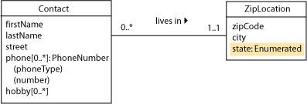
Design Pattern: Enumerated Domains – Class Diagram
In our earlier ZipLocations example, the state attribute clearly fits the definition of an enumerated domain. In UML, we can simply use a data type specification to show this, without adding a new class type.

Slide 127
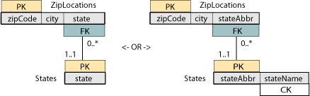
Design Pattern: Enumerated Domains – Relation Scheme
The relation scheme will show the table that contains the enumerated domain values. This table might have a single attribute, or it might have two attributes: one for the true values and one for a substitute key. The true values always form a candidate key of the table.

Slide 128
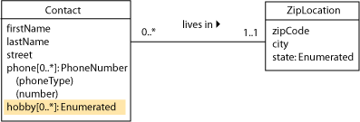
Design Pattern: Enumerated Domains – Multi-Valued Attributes
Multi-valued attributes might also have enumerated domains.

Slide 129
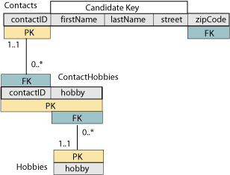
Design Pattern: Enumerated Domains – Many-to-Many Relation Scheme
In the scheme, the relationship between Contacts and Hobbies has become many-to-many, instead of one-to-many. This is shown in the scheme by linking an enumeration table to the previous Hobbies tables (which now functions like an association class).

Slide 130
Exercise: a Pizza Shop
You are designing a database for a pizza shop that wants to get into Web-based sales. Your client has given you the transcript of a typical phone order conversation:
  Pizza shop associate (Lori): Thank you for calling the Pizza Shop; this is Lori. How may I help you?
  Caller (Rick): What toppings do you put on your all-meat special?
  Lori: Italian sausage, pepperoni, ground beef, salami, and bacon.
  Rick: OK, I'd like a large one, but without the bacon.
  Lori: Do you want regular crust, extra-thin, or whole wheat?
  Rick: Regular is fine. And a medium wheat crust with just cheese.
  Lori: We have mozzarella, parmesan, romano, smoked cheddar, and jalapeno jack.
  Rick: Uhhh just mozzarella and romano. What kind of sauce is on that?
  Lori: Marinara, spicy southwestern, tandoori masala, or pestoyour choice.
  Rick: Pesto sounds good.

Slide 131
Exercise: a Pizza Shop
  Lori: You can add a large order of breadsticks for just 99 cents.
  Rick: Sure, why not? And I'd like three small salads (muffled) make two of'em with Italian dressing and one with ranch.
  Lori: The dressing comes on the side; we'll give you an extra one of each flavor. What would you like to drink?
  Rick: Keg'a beer, maybe?
  Lori: Sorry, we just have soft drinks.
  Rick: (laughs) Just kidding how about two medium diet colas and a large iced tea.
  Lori: That's one large regular crust all-meat special, no bacon, one medium wheat crust with pesto sauce, mozzarella and romano, one large order of breadsticks, three small salads, three Italian dressing, two ranch, two medium diet colas and one large iced tea. Just a minute, please (cash register clicks several times) your total with tax is 27 dollars and 39 cents. Is this for pickup or delivery?

Slide 132
Exercise: a Pizza Shop
  Rick: I'll pick it up.
  Lori: And your name?
  Rick: Rick.
  Lori: Thank you for your order, Rick. It'll be ready in about 20 minutes.
  Rick: See'ya then.
Develop a list of the enumerated attributes that are discussed in this conversation.

Slide 133
Design Pattern: Subclasses –Top Down Design
As you are developing a class diagram, you might discover that one or more attributes of a class are characteristics of only some individuals of that class, but not of others. This probably indicates that you need to develop a subclass of the basic class type. We call the process of designing subclasses from “top down” specialization. A class that represents a subset of another class type can also be called a specialization of its parent class.
Example: we will model the graduate students at a university. Some are employed by the university as teaching associates (TAs). Some are employed as research associates (RAs). Some are not employed by the university at all. For the TAs, we need to know which course they are assigned to teach. For the RAs, we need to know the grant number of the research project to which they are assigned.

Slide 134
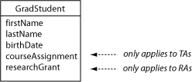
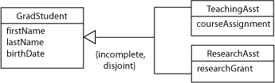
Design Pattern: Subclasses –Top Down Design – Class Diagrams
Note that one of the attributes courseAssignment or researchGrant will always be null
Common attributes are in the parent class, unique attributes are in the subclass

Slide 135
Design Pattern: Subclasses –Top Down Design–Specialization Constraints
Rather than with the usual cardinality symbols, the subclass association line is label with specialization constraints. Constraints are described along two dimensions: incomplete vs. complete, and disjoint vs. overlapping.
  incomplete or partial specialization, only some individuals of the parent class are specialized.
  complete specialization, all individuals of the parent class have one or more unique attributes that are not common to the generalized (parent) class.
  disjoint or exclusive specialization, an individual of the parent class may be a member of only one specialized subclass.
  overlapping specialization, an individual of the parent class may be a member of more than one specialized subclass.

Slide 136

Design Pattern: Subclasses –Top Down Design – Relation Scheme
Note that the PK of the parent is the PK/FK of the child as this is a one-to-one relationship.

Slide 137
Design Pattern: Subclasses - Bottom Up Design
Sometimes, instead of finding unique attributes in a single class type, you might find two or more classes that have many of the same attributes. This probably indicates that you need to develop a superclass of the classes with common attributes.
We call the process of designing subclasses from “bottom up” generalization. A class or entity that represents a superset of other class types can also be called a generalization of the child types.
Example: Consider a brush-clearing service. This is a fairly specialized business, where dried plant growth (brush) can present a severe fire hazard if it is not cleared from around houses and other structures.

Slide 138

Design Pattern: Subclasses – Bottom Up Design – Class Diagram
One important class type was the lot (or property) to be cleared. Some lots were in the city, with a standard street-and-number address.
Other lots were not on a city street, but were described by the county surveyor's section and tract number.
It seemed as if there were two class types:

Slide 139


Design Pattern: Subclasses – Bottom Up Design – Relation Scheme
Actually, a few of the lots were identified by both address schemes. A closer look at the city and county lot classes also shows two common descriptive attributes (the owner and the lot size). The common attributes should go in a generalization or superclass that is simply called a “lot.”

Slide 140
Exercise: Sales Commission
The training material for a well-known database system includes an example employee class with standard attributes such as employee ID, name, and so on.
The same entity also includes both a salary attribute and a commission attribute, even though only sales representatives earn a commission. (Everyone earns a salary.)
In their lesson plans, this vendor emphasizes various ways that their software can handle the inevitable null values of the commission attribute.

Slide 141

Exercise: Sales Commission
I believe that their model is simply wrong.
Design a better way to preserve the salary and commission information but preclude null values in any of the attributes.
Draw the class diagram and the relation scheme.

Slide 142
Design Pattern: Aggregation
An aggregation is when a class type really represents a collection of individual components. Although this pattern can be modeled by an ordinary association, its meaning becomes much clearer if we use the UML notation for an aggregation.
Example: a small business needs to keep track of its computer systems. They want to record information such as model and serial number for each system and its components.

Slide 143

Design Pattern: Aggregation – Incorrect Model vs. Improved Model
Note that the incorrect model uses repeated attributes for the components. This is fixed in the improved model although there are still some problems – what if there are components on the shelf that don’t belong to a system

Slide 144

Design Pattern: Aggregation – Model with UML Aggregation
The system is an aggregation of components.
There is an implied multiplicity on the diamond end of 0..1 with multiplicity of the other end shown in the diagram.

Slide 145

Design Pattern: Aggregation – Relation Scheme
Since the component can exist by itself in this model the system name can’t be part of its PK.
We use the only candidate key {type,mgr,model,SN} as the PK since this class is not a parent. The system name, will be filled in if the component is installed as part of a system, otherwise it will be null.

Slide 146
Design Pattern: Aggregation – Composition
A composition is a stronger form of aggregation. The notation is similar using a filled-in diamond instead of an open one. In a composition, a component instance cannot exist on its own without a parent.
The implied multiplicity on the diamond end is 1..1.

Slide 147

Design Pattern: Aggregation – Composition Examples

Slide 148
Design Pattern: Aggregation – Definitions
Aggregation – (“has a” relationship)
In an aggregation relationship, the part may be independent of the whole but the whole requires the part.
Composition – (“uses a” relationship)
A composition relationship, also know as a composite aggregation, is a stronger form of aggregation where the part is created and destroyed with the whole.

Slide 149
Design Pattern: Recursive Associations
A recursive association connects a single class type (serving in one role) to itself (serving in another role).
Example: employees and their managers

Slide 150

Design Pattern: Recursive Associations – Incorrect Relationship
The problem with this model is that each manager is also an employee so the manager table duplicates information in the employee table.

Slide 151

Design Pattern: Recursive Associations – Correct Relationship
Normally, we wouldn’t show an FK in the class diagram; however, including the manager as an attribute of the employee here (in addition to the association line) can help in understanding the model.

Slide 152

Design Pattern: Recursive Associations – Relation Scheme
In the relation scheme, we can explicitly show the connection between the surrogate PK (employeeID) and the managerID (which is an FK, even though it is in the same scheme).

Slide 153

Design Pattern: Recursive Associations – Many-to-Many Class Diagram
In some project-oriented companies, an employee might work for more than one manager at a time.
We also might want to keep a history of the employees’ supervision assignments over time. We can model either case by revising the class diagram to a many-to-many pattern.

Slide 154

Design Pattern: Recursive Associations – Many-to-Many Relation Scheme
The relation scheme for this model looks exactly like other many-to-many applications, with the exception that both foreign keys come from the same PK table.

Slide 155

Design Pattern: Recursive Associations – Retrieving Data
SELECT E.lastName AS "Employee", M.lastName AS "Manager"
FROM Employees E LEFT OUTER JOIN Employees M
ON E.managerID = M.employeeID
ORDER BY E.lastName

Slide 156
Design Pattern: Recursive Associations – Retrieving Data Many-to-Many
SELECT E.lastName AS "Employee", M.lastName AS "Manager"
FROM Employees E LEFT OUTER JOIN (Supervisions S INNER JOIN Employees M ON S.managerID = M.employeeID)
ON E.employeeID = S.employeeID
ORDER BY E.lastName

Slide 157
Exercise: Team Games
You are modeling a sports league. It could be any team sport.
Certainly one important class is the team, which will have a name (unique within the league), a coach, a home field or venue, and probably more attributes.
Obviously, teams play games. In each game, there is a designated home team and away team (even if the game is played at a neutral venue).
Teams may play each other more than once during a season, possibly even with the same home and away roles (for example, during playoffs).
Design a class diagram that shows the teams, the games that they play, and the score of each game.
Then draw the relation scheme for your model.

Slide 158
Appendix: Traditional Normalization
Normalization is usually thought of as a process of applying a set of rules to your database design, mostly to achieve minimum redundancy in the data. Most textbooks present this as a three-step process, with correspondingly label “normal forms.
In theory, you could start with a single relation scheme (sometimes called the universal scheme, or U) that contains all of the attributes in the database—then apply these rules recursively to develop a set of increasingly-normalized sub-relation schemes. When all of the schemes are in third normal form, then the whole database is properly normalized.
In practice, you will more likely apply the rules gradually, refining each relation scheme as you develop it from the UML class diagram or ER model diagram. The final table structures should be the same no matter which method (or combination of methods) you’ve used.

Slide 159

Appendix: Traditional Normalization – Normal Forms

Slide 160
Functional Dependency-FD
A functional dependency (FD) is a type of relationship between attributes
If A and B are sets of attributes of relation R, we say B is functionally dependent on A if each A value in R has associated with it exactly one value of B in R.
Alternatively, if two tuples have the same A values, they must also have the same B values
Write A→B, read A functionally determines B, or B functionally dependent on A
FD is actually a many-to-one relationship between A and B

Slide 161
Example of FDs
Stuid | lastName | major | credits | status | socSecNo
S1001 | Smith | History | 90 | Senior | 100429500
S1003 | Jones | Math | 95 | Senior | 010124567
S1006 | Lee | CSC | 15 | Freshman | 088520876
S1010 | Burns | Art | 63 | Junior | 099320985
S1060 | Jones | CSC | 25 | Freshman | 064624738
Let R be
NewStudent(stuId, lastName, major, credits, status, socSecNo)
FDs in R include
{stuId}→{lastName}, but not the reverse
{stuId} →{lastName, major, credits, status, socSecNo, stuId}
{socSecNo} →{stuId, lastName, major, credits, status, socSecNo}
{credits}→{status}, but not {status}→{credits}

Slide 162
Trivial Functional Dependency
The FD X→Y is trivial if set {Y} is a subset of set {X}
Examples: If A and B are attributes of R,
{A}→{A}
{A,B} →{A}
{A,B} →{B}
{A,B} →{A,B}
are all trivial FDs

Slide 163
First Normal Form-1NF
A relation is in 1NF if and only if every attribute is single-valued for each tuple
Each cell of the table has only one value in it
Domains of attributes are atomic: no sets, lists, repeating fields or groups allowed in domains

Slide 164
Counter-Example for 1NF
Stuid | lastName | major | credits | status | socSecNo
S1001 | Smith | History | 90 | Senior | 100429500
S1003 | Jones | Math | 95 | Senior | 010124567
S1006 | Lee | Math | 15 | Freshman | 088520876
 |  | CSC
S1010 | Burns | English | 63 | Junior | 099320985
 |  | Art
S1060 | Jones | CSC | 25 | Freshman | 064624738
NewStu(StuId, lastName, major, credits, status, socSecNo) – Assume students can have more than one major
The major attribute is not single-valued for each tuple

Slide 165
Ensuring 1NF
Best solution: For each multi-valued attribute, create a new table, in which you place the key of the original table and the multi-valued attribute. Keep the original table, with its key
Ex. NewStu2(stuId, lastName, credits,status, socSecNo)
Majors(stuId, major)
NewStu2
Majors
stuId | major
S1001 | History
S1003 | Math
S1006 | CSC
S1006 | Math
S1010 | Art
S1010 | English
S1060 | CSC
Stuid | lastName | credits | status | socSecNo
S1001 | Smith | 90 | Senior | 100429500
S1003 | Jones | 95 | Senior | 010124567
S1006 | Lee | 15 | Freshman | 088520876
S1010 | Burns | 63 | Junior | 099320985
S1060 | Jones | 25 | Freshman | 064624738

Slide 166
Full Functional Dependency
In relation R, set of attributes B is fully functionally dependent on set of attributes A of R if B is functionally dependent on A but not functionally dependent on any proper subset of A
This means every attribute in A is needed to functionally determine B
Must have multivalued key for relation to have FD problem

Slide 167
Partial Functional Dependency Example
NewClass( courseNo, stuId, stuLastName, facId, schedule, room, grade)
FDs:
{courseNo,stuId} → {lastName}
{courseNo,stuId} →{facId}
{courseNo,stuId} →{schedule}
{courseNo,stuId} →{room}
{courseNo,stuId} →{grade}
courseNo → facId **partial FD
courseNo → schedule **partial FD
courseNo →room ** partial FD
stuId → lastName ** partial FD
…plus trivial FDs that are partial…

Slide 168
Second Normal Form-2NF
A relation is in second normal form (2NF) if it is in first normal form and all the non-key attributes are fully functionally dependent on the key.
No non-key attribute is FD on just part of the key
If key has only one attribute, and R is 1NF, R is automatically 2NF

Slide 169
Converting to 2NF
Identify each partial FD
Remove the attributes that depend on each of the determinants so identified
Place these determinants in separate relations along with their dependent attributes
In original relation keep the composite key and any attributes that are fully functionally dependent on all of it
Even if the composite key has no dependent attributes, keep that relation to connect logically the others

Slide 170
2NF Example
NewClass(courseNo, stuId, stuLastName, facId, schedule, room, grade )
FDs grouped by determinant:
{courseNo} → {courseNo,facId, schedule, room}
{stuId} → {stuId, lastName}
{courseNo,stuId} → {courseNo, stuId, facId, schedule, room, lastName, grade}
Create tables grouped by determinants:
Class2(courseNo,facId, schedule, room)
Stu(stuId, lastName)
Keep relation with original composite key, with attributes FD on it, if any
Register( courseNo, stuId, grade)

Slide 171
2NF Example
courseNo | stuId | stuLastName | facId | schedule | room | grade
ART103A | S1001 | Smith | F101 | MWF9 | H221 | A
ART103A | S1010 | Burns | F101 | MWF9 | H221
ART103A | S1006 | Lee | F101 | MWF9 | H221 | B
CSC201A | S1003 | Jones | F105 | TUTHF10 | M110 | A
CSC201A | S1006 | Lee | F105 | TUTHF10 | M110 | C
HST205A | S1001 | Smith | F202 | MWF11 | H221
First Normal Form Relation
Register
Stu
Class2
courseNo | stuId | grade
ART103A | S1001 | A
ART103A | S1010
ART103A | S1006 | B
CSC201A | S1003 | A
CSC201A | S1006 | C
HST205A | S1001
stuId | stuLastName
S1001 | Smith
S1010 | Burns
S1006 | Lee
S1003 | Jones
courseNo | facId | schedule | room
ART103A | F101 | MWF9 | H221
CSC201A | F105 | TUTHF10 | M110
HST205A | F202 | MWF11 | H221
Second Normal Form Relations

Slide 172
Transitive Dependency
If A, B, and C are attributes of relation R, such that A → B, and B → C, then C is transitively dependent on A
Example:
NewStudent (stuId, lastName, major, credits, status)
FD:
credits→status (and several others)
By transitivity:
stuId→credits ∧ credits→status implies stuId→status
Transitive dependencies cause update, insertion, deletion anomalies.

Slide 173
Third Normal Form-3NF
A relation is in third normal form (3NF) if whenever a non-trivial functional dependency X→A exists, then either X is a superkey or A is a member of some candidate key
To be 3NF, relation must be 2NF and have no transitive dependencies
No non-key attribute determines another non-key attribute. Here key includes “candidate key”

Slide 174
Example Transitive Dependency
NewStudent
Stuid | lastName | Major | Credits | Status
S1001 | Smith | History | 90 | Senior
S1003 | Jones | Math | 95 | Senior
S1006 | Lee | CSC | 15 | Freshman
S1010 | Burns | Art | 63 | Junior
S1060 | Jones | CSC | 25 | Freshman
Transitive Dependency: Stuid → Credits and Credits → Status
NewStu2
Stats
Stuid | lastName | Major | Credits
S1001 | Smith | History | 90
S1003 | Jones | Math | 95
S1006 | Lee | CSC | 15
S1010 | Burns | Art | 63
S1060 | Jones | CSC | 25
Credits | Status
15 | Freshman
25 | Freshman
63 | Junior
90 | Senior
95 | Senior
Removed Transitive Dependency

Slide 175
Making a relation 3NF
For example,
NewStudent (stuId, lastName, major, credits, status)
with FD credits→status
Remove the dependent attribute, status, from the relation
Create a new table with the dependent attribute and its determinant, credits
Keep the determinant in the original table
NewStu2 (stuId, lastName, major, credits)
Stats (credits, status)

Slide 176
Appendix: Traditional Normalization – Denormalization
You database will always be part of a larger system, which will include at least a user interface and reporting structure or the back-end of a Web site, with both middle-tier business logic and front-end presentation code dependent on it.
It is not uncommon for developers to “break the rules” of database design in order to accommodate other parts of a system. This is called denormalization.

Slide 177
Appendix: Traditional Normalization – Denormalization for Efficiency
An example of denormalization, using our “phone book” problem, would be to store the city and state attributes in the basic contacts table, rather than making a separate zip codes table.
At the cost of extra storage, this would save one join in a SELECT statement. Although this would certainly not be needed in such a simple system, imagine a Web site that supports thousands of “hits” per second, with much more complicated queries needed to produce the output.
With today’s terabyte disk systems, it might be worth using extra storage space to keep Web viewers from waiting excessively while a page is being generated.

Slide 178
Boyce-Codd Normal Form-BCNF
A relation is in Boyce/Codd Normal Form (BCNF) if whenever a non-trivial functional dependency X→A exists, then X is a superkey
(trivial means that A is a subset of X)
Stricter than 3NF, which allows A to be part of a candidate key
If there is just one single candidate key, the forms are equivalent

Slide 179
BCNF Example
NewFac (facName, dept, office, rank, dateHired)
FDs:
office → dept
facName,dept → office, rank, dateHired
facName,office → dept, rank, dateHired
NewFac is 3NF but not BCNF because office is not a superkey
To make it BCNF, remove the dependent attributes to a new relation, with the determinant as the key
Decompose into
Fac1 (office, dept)
Fac2 (facName, office, rank, dateHired)
Note we have lost a functional dependency in Fac2 – no longer able to see that {facName, dept} is a determinant, since they are in different relations

Slide 180
Example Boyce-Codd Normal Form
Faculty
facName | dept | office | rank | dateHired
Adams | Art | A101 | Professor | 1975
Byrne | Math | M201 | Assistant | 2000
Davis | Art | A101 | Associate | 1992
Gordon | Math | M201 | Professor | 1982
Hughes | Mth | M203 | Associate | 1990
Smith | CSC | C101 | Professor | 1980
Smith | History | H102 | Associate | 1990
Tanaka | CSC | C101 | Instructor | 2001
Vaughn | CSC | C101 | Associate | 1995
Fac1
Fac2
office | dept
A101 | Art
C101 | CSC
C105 | CSC
H102 | History
M201 | Math
M203 | Math
facName | office | rank | dateHired
Adams | A101 | Professor | 1975
Byrne | M201 | Assistant | 2000
Davis | A101 | Associate | 1992
Gordon | M201 | Professor | 1982
Hughes | M203 | Associate | 1990
Smith | C101 | Professor | 1980
Smith | H102 | Associate | 1990
Tanaka | C101 | Instructor | 2001
Vaughn | C101 | Associate | 1995

Slide 181
Converting to BCNF
Identify all determinants and verify that they are superkeys in the relation
If not, break up the relation by decomposition
  for each non-superkey determinant, create a separate relation with all the attributes it determines, also keeping it in original relation
  Preserve the ability to recreate the original relation by joins.
Repeat on each relation until you have a set of relations all in BCNF

Slide 182
Normalization Example
Relation that stores information about projects in large business
  Work (projName, projMgr, empId, hours, empName, budget, startDate, salary, empMgr, empDept, rating)
prijName | projMgr | empId | hours | Emp Name | budget | startDate | salary | Emp Mgr | Emp Dept | rating
Jupiter | Smith | E101 | 25 | Jones | 100000 | 01/15/04 | 60000 | Levine | 10 | 9
Jupiter | Smith | E105 | 40 | Adams | 100000 | 01/15/04 | 55000 | Jones | 12
Jupiter | Smith | E110 | 10 | Rivera | 100000 | 01/15/04 | 43000 | Levine | 10 | 8
Maxima | Lee | E101 | 15 | Jones | 200000 | 03/01/04 | 60000 | Levine | 10
Maxima | Lee | E110 | 30 | Rivera | 200000 | 03/01/04 | 43000 | Levine | 10
Maxima | Lee | E120 | 15 | Tanaka | 200000 | 03/01/04 | 45000 | Jones | 15

Slide 183
Normalization Example (cont)
Each project has a unique name.
Although project names are unique, names of employees and managers are not.
Each project has one manager, whose name is stored in projMgr.
Many employees can be assigned to work on each project, and an employee can be assigned to more than one project. The attribute hours tells the number of hours per week a particular employee is assigned to work on a particular project.
budget stores the amount budgeted for a project, and startDate gives the starting date for a project.
salary gives the annual compensation of an employee.

Slide 184
Normalization Example (cont)
empMgr gives the name of the employee’s manager, who might not be the same as the project manager.
empDept gives the employee’s department. Department names are unique. The employee’s manager is the manager of the employee’s department.
rating gives the employee’s performance for a particular project. The project manager assigns the rating at the end of the employee’s work on the project.

Slide 185
Normalization Example (cont)
Functional dependencies
  projName → projMgr, budget, startDate
  empId → empName, salary, empMgr, empDept
  projName, empId → hours, rating
  empDept → empMgr
  empMgr does not functionally determine empDept since people's names were not unique (different managers may have same name and manage different departments or a manager may manage more than one department
  projMgr does not determine projName
Primary Key
  projName, empId since every member depends on that combination

Slide 186
Normalization Example (cont)
First Normal Form
  With the primary key each cell is single valued, Work in 1NF
Second Normal Form
  Partial dependencies
    projName → projMgr, budget, startDate
    empId → empName, salary, empMgr, empDept
  Transform to
    Proj (projName, projMgr, budget, startDate)
    Emp (empId, empName, salary, empMgr, empDept)
    Work1 (projName, empId, hours, rating)

Slide 187
Normalization Example (cont)
Second Normal Form
Work1
Proj
prijName | empId | hours | rating
Jupiter | E101 | 25 | 9
Jupiter | E105 | 40
Jupiter | E110 | 10 | 8
Maxima | E101 | 15
Maxima | E110 | 30
Maxima | E120 | 15
prijName | projMgr | budget | startDate
Jupiter | Smith | 100000 | 01/15/04
Maxima | Lee | 200000 | 03/01/04
Emp
empId | empName | salary | empMgr | empDept
E101 | Jones | 60000 | Levine | 10
E105 | Adams | 55000 | Jones | 12
E110 | Rivera | 43000 | Levine | 10
E101 | Jones | 60000 | Levine | 10
E110 | Rivera | 43000 | Levine | 10
E120 | Tanaka | 45000 | Jones | 15

Slide 188
Normalization Example (cont)
Third Normal Form
  Proj in 3NF – no non-key atrribute functionally determines another non-key attribute
  Work1 in 3NF – no transitive dependency involving hours or rating
  Emp not in 3NF – transitive dependency
    empDept → empMgr and empDept is not a superkey, nor is empMgr part of a candidate key
    Need two relations
      Emp1 (empId, empName, salary, empDept)
      Dep (empDept, empMgr)

Slide 189
Normalization Example (cont)
Third Normal Form
Emp1
Dept
empId | empName | salary | empDept
E101 | Jones | 60000 | 10
E105 | Adams | 55000 | 12
E110 | Rivera | 43000 | 10
E120 | Tanaka | 45000 | 15
empDept | empMgr
10 | Levine
12 | Jones
15 | Jones
Proj
Work1
prijName | projMgr | budget | startDate
Jupiter | Smith | 100000 | 01/15/04
Maxima | Lee | 200000 | 03/01/04
prijName | empId | hours | rating
Jupiter | E101 | 25 | 9
Jupiter | E105 | 40
Jupiter | E110 | 10 | 8
Maxima | E101 | 15
Maxima | E110 | 30
Maxima | E120 | 15
This is also BCNF since the only determinant in each relation is the primary key

Slide 190
Decomposition
Definition: A decomposition of a relation R is a set of relations {R₁,R₂,...,R_{n}} such that each R_{i} is a subset of R and the union of all of the R_{i} is R.
Starting with a universal relation that contains all the attributes of a schema, we can decompose into relations

Slide 191
Desirable Properties of Decompositions
Attribute preservation - every attribute is in some relation
Dependency preservation – all FDs are preserved
Lossless decomposition – can get back the original relation by joins

Slide 192
Dependency Preservation
If R is decomposed into {R₁,R₂,…,R_{n},} so that for each functional dependency X→Y all the attributes in X ∪ Y appear in the same relation, R_{i}, then all FDs are preserved
Allows DBMS to check each FD constraint by checking just one table for each

Slide 193
Example
Sometimes more important to maintain functional dependencies that it is to get the relation in BCNF
NewFac (facName, dept, office, rank, dateHired)
FDs:
office → dept
facName,dept → office, rank, dateHired
facName,office → dept, rank, dateHired
NewFac is not BCNF because office is not a superkey
To make it BCNF, remove the dependent attributes to a new relation, with the determinant as the key
Project into
Fac1 (office, dept)
Fac2 (facName, office, rank, dateHired)
Note we have lost a functional dependency in Fac2 – no longer able to see that {facName, dept} is a determinant, since they are in different relations

Slide 194
Multi-valued Dependency
In R(A,B,C) if each A values has associated with it a set of B values and a set of C values such that the B and C values are independent of each other, then A multi-determines B and A multi-determines C
Multi-valued dependencies occur in pairs
Example: JointAppoint(facId, dept, committee) assuming a faculty member can belong to more than one department and belong to more than one committee
Table must list all combinations of values of department and committee for each facId

Slide 195
Lossless Decomposition
A decomposition of R into {R₁, R₂,....,R_{n}} is lossless if the natural join of R₁, R₂,...,R_{n} produces exactly the relation R
No spurious tuples are created when the projections are joined.
always possible to find a BCNF decomposition that is lossless

Slide 196
Example of Lossy Decomposition
Original EmpRoleProj table: tells what role(s) each employee plays in which project(s)
EmpName role projName
Smith designer Nile
Smith programmer Amazon
Smith designer Amazon
Jones designer Amazon
Project into two tables Table a(empName, role), Table b( role, projname)
Table a Table b
EmpName role role projName
Smith designer designer Nile
Smith programmer programmer Amazon
Jones designer designer Amazon
Joining Table a and Table b produces
EmpName role projName
Smith designer Nile
Smith designer Amazon
Smith programmer Amazon
Jones designer Nile ← spurious tuple
Jones designer Amazon

Slide 197
Lossless Decomposition
Lossless property guaranteed if for each pair of relations that will be joined, the set of common attributes is a superkey of one of the relations
Binary decomposition of R into {R₁,R₂} lossless iff one of these holds
        R1 ∩ R2 → R1 - R2
        or
        R1 ∩ R2 → R2 - R1
If projection is done by successive binary projections, can apply binary decomposition test repeatedly

Slide 198
Algorithm to Test for Lossless Join
Given a relation R(A1,A2,…An), a set of functional dependencies, F, and a decomposition of R into Relations R1, R2, …Rm, to determine whether the decomposition has a lossless join
  Construct an m by n table, S, with a column for each of the n attributes in R and a row for each of the m relations in the decomposition
  For each cell S(I,j) of S,
    If the attribute for the column, Aj, is in the relation for the row, Ri, then place the symbol a(j) in the cell else place the symbol b(I,j)there
  Repeat the following process until no more changes can be made to Sc for each FD X → Y in F
    For all rows in S that have the same symbols in the columns corresponding to the attributes of X, make the symbols for the columns that represent attributes of Y equal by the following rule:
      If any row has an a value,. A(j), then set the value of that column in all the other rows equal to a(j)
      If no row ahs an a value, then pick any one of the b values, say b(I,j), and set all the other rows equal to b(I,j)
  If, after all possible changes have been made to S, a row is made up entirely of a symbols, a(1, a(2, …,a(n), then the join is lossless. If there is no such row, the join is lossy.

Slide 199
Normalization Methods
Analysis
  Decomposition method shown previously
Synthesis
  Begin with attributes, combine them into groups having the same determinant
  Use functional dependencies to develop a set of normalized relations
Mapping from ER diagram provides almost-normalized schema

Slide 200
De-normalization
When to stop the normalization process
  When applications require too many joins
  When you cannot get a non-loss decomposition that preserves dependencies

Slide 201
Inference Rules for FDs
Armstrong’s Axioms
  Reflexivity If B is a subset of A, then A → B..
  Augmentation If A → B, then AC → BC.
  Transitivity If A → B and B → C, then A → C
Additional rules that follow:
  Additivity If A → B and A → C, then A → BC
  Projectivity If A → BC, then A → B and A → C
  Pseudotransitivity If A → B and CB → D, then AC → D

Slide 202
Closure of Set of FDs
If F is a set of functional dependencies for a relation R, then the set of all functional dependencies that can be derived from F, F⁺, is called the closure of F
Could compute closure by applying Armstrong’s Axioms repeatedly

Slide 203
Closure of an Attribute
If A is an attribute or set of attributes of relation R, all the attributes in R that are functionally dependent on A in R form the closure of A, A⁺
Computed by Closure Algorithm for A
result ← A;
  while (result changes) do
  for each functional dependency B → C in F
  if B is contained in result then result ← result ∪ C;
  end;
  A⁺ ← result;

Slide 204
Uses of Attribute Closure
Can determine if A is a superkey-if every attribute in R functionally dependent on A
Can determine whether a given FD X→Y is in the closure of the set of FDs. (Find X⁺, see if it includes Y)

Slide 205
Redundant FDs and Covers
Given a set of FDs, can determine if any of them is redundant, i.e. can be derived from the remaining FDs, by a simple
If a relation R has two sets of FDs, F and G
  then F is a cover for G if every FD in G is also in F⁺
  F and G are equivalent if F is a cover for G and G is a cover for F (i.e. F⁺ = G⁺)

Slide 206
Minimal Set of FDs
Set of FDs, F is minimal if
  The right side of every FD in F has a single attribute (called standard or canonical form)
  No attribute in the left side of any FD is extraneous
  F has no redundant FDs

Slide 207
Minimal Cover for Set of FDs
A minimal cover for a set of FDs is a cover such that no proper subset of itself is also a cover
A set of FDs may have several minimal covers

Slide 208
Synthesis Algorithm for 3NF
Can always find 3NF decomposition that is lossless and that preserves all FDs
3NF Algorithm uses synthesis
  Begin with universal relation and set of FDs,G
  Find a minimal cover for G
  Combine FDs that have the same determinant
  Include a relation with a key of R

Slide 209
Basic Queries: SQL and RA
To look at the data in tables, we use the SELECT statement. The result of this statement is always a new table that we can view with our database client software or use with programming languages to build dynamic web pages or desktop applications.
Although the result table is not stored in the database we can also use it as part of other SELECT statements.

Slide 210
Basic Queries: SQL and RA – Required Clauses
Only the SELECT and FROM clauses are required.
SELECT <attribute names>
FROM <table names>
WHERE <condition to pick rows>
ORDER BY <attribute names>;

Slide 211

Basic Queries: SQL and RA – Retrieving Data Step 1
Look at all of the relevant data—this is called the result set of the query, and it is specified in the FROM clause. We have only one table, so the result set should consist of all the columns (* means all attributes) and rows of this table.
SELECT * FROM customers;

Slide 212

Basic Queries: SQL and RA – Retrieving Data Step 2
Pick the specific rows you want from the result set (for example here, all customers who live in zip code 90840). Notice the single quotes around the string you’re looking for—search strings are case sensitive!
SELECT * FROM customers
WHERE cZipCode = '90840';

Slide 213

Basic Queries: SQL and RA – Retrieving Data Step 3
Pick the attributes (columns) you want. Notice that changing the order of the columns (like showing the last name first) does not change the meaning of the data.
SELECT cLastName, cFirstName, cPhone
FROM customers
WHERE cZipCode = '90840';

Slide 214

Basic Queries: SQL and RA – Retrieving Data Step 4
In SQL, you can also specify the order in which to list the results. Once again, the order in which rows are listed does not change the meaning of the data in them.
SELECT cLastName,cFirstName,cPhone
FROM customers
WHERE cZipCode = '90840'
ORDER BY cLastName, cFirstName;

Slide 215
Basic queries: SQL and RA – Why SQL Works
Like all algebras, Relational Algebra (RA) applies operators to operands to produce results. RA operands are relations. Results are new relations that can be used as operands in building more complex expressions.
select(RA) and project(RA) are two RA operators that were used in the prior example

Slide 216
Basic queries: SQL and RA – Select and Project Step 1
To represent a single relation in RA, we only need to use its name. We can also represent relations and schemes symbolically with small and capital letters, for example relation r over scheme R. In this case, r = customers and R = the Customers scheme.

Slide 217
Basic queries: SQL and RA – Select and Project Step 2
The select (RA) operator (written σ) picks tuples, like the SQL WHERE clause picks rows. It is a unary operator that takes a single relation or expression as its operand. It also takes a predicate, θ, to specify which tuples are required. Its syntax is σθr, or in our example:
σcZipCode='90840'customers.
The scheme of the result of σθr is R—the same scheme we started with—since we haven’t done anything to change the attribute list. The result of this operation includes all tuples of r for which the predicate θ evaluates to true.

Slide 218
Basic queries: SQL and RA – Select and Project Step 3
The project (RA) operator (written π) picks attributes, confusingly like the SQL SELECT clause. It is also a unary operator that takes a single relation or expression as its operand. Instead of a predicate, it takes a subscheme, X (of R), to specify which attributes are required. Its syntax is πXr, or in our example:
^{π}cLastName, cFirstName, cPhone^{customers}.
The scheme of the result of πXr is X. The tuples resulting from this operation are tuples of the original relation, r, cut down to the attributes contained in X.
  For X to be a subscheme of R, it must be a subset of the attributes in R, and preserve the assignment rule from R (that is, each attribute of X must have the same domain as its corresponding attribute in R).
  If X is a super key of r, then there will be the same number of tuples in the result as there were to begin with in r. If X is not a super key of r, then any duplicate (non-distinct) tuples are eliminated from the result.
Just as in the SQL statement, we can apply the project operator to the output of the select operation to produce the results that we want: πXσθr or
^{π}cLastName, cFirstName, cPhone σcZipCode='90840'^{customers}.

Slide 219
Basic queries: SQL and RA – Select and Project Step 4
Since RA considers relations strictly as sets of tuples, there is no way to specify the order of tuples in a result relation.

Slide 220
Basic SQL Statements: DDL and DML
SQL statements are divided into two major categories:
  data definition language (DDL) - used to build and modify the structure of your tables and other objects in the database
  data manipulation language (DML) - used to work with the data in tables
All of the information about objects in your schema is contained in a set of tables called the data dictionary.

Slide 221
Basic SQL Statements: DDL and DML – DDL- CREATE Statement
The CREATE TABLE statement does exactly that:
CREATE TABLE <table name> (
<attribute name 1> <data type 1>,
...
<attribute name n> <data type n>);
The data types that you will use most frequently are character strings, which might be called VARCHAR or CHAR for variable or fixed length strings; numeric types such as NUMBER or INTEGER, which will usually specify a precision; and DATE or related types.
Data type syntax is variable from system to system; the only way to be sure is to consult the documentation for your own software.

Slide 222
Basic SQL Statements: DDL and DML – DDL- ALTER TABLE Statement
The ALTER TABLE statement may be used as you have seen to specify primary and foreign key constraints, as well as to make other modifications to the table structure. Key constraints may also be specified in the CREATE TABLE statement.
ALTER TABLE <table name>
ADD CONSTRAINT <constraint name>
PRIMARY KEY (<attribute list>);
You get to specify the constraint name. Get used to following a convention of tablename_pk (for example, Customers_pk), so you can remember what you did later.
The attribute list contains the one or more attributes that form this PK; if more than one, the names are separated by commas.

Slide 223
Basic SQL Statements: DDL and DML – DDL- Foreign Key Constraint
The FOREIGN KEY CONSTRAINT is a bit more complicated, since we have to specify both the FK attributes in this (child) table, and the PK attributes that they link to in the parent table.
ALTER TABLE <table name>
ADD CONSTRAINT <constraint name>
FOREIGN KEY (<attribute list>)
REFERENCES <parent table name> (<attribute list>);
Name the constraint in the form childtable_parenttable_fk (for example, Orders_Customers_fk). If there is more than one attribute in the FK, all of them must be included (with commas between) in both the FK attribute list and the REFERENCES (parent table) attribute list.
You need a separate foreign key definition for each relationship in which this table is the child.

Slide 224
Basic SQL Statements: DDL and DML – DDL- DROP statement
If you totally mess things up and want to start over, you can always get rid of any object you’ve created with a drop statement. The syntax is different for tables and constraints.
DROP TABLE <table name>;
ALTER TABLE <table name>
DROP CONSTRAINT <constraint name>;
This is where consistent constraint naming comes in handy, so you can just remember the PK or FK name rather than remembering the syntax for looking up the names in another table.
The DROP TABLE statement gets rid of its own PK constraint, but won’t work until you separately drop any FK constraints (or child tables) that refer to this one. It also gets rid of all data that was contained in the table—and it doesn't even ask you if you really want to do this!

Slide 225
Basic SQL statements: DDL and DML – DML
When you are connected to most multi-user databases (whether in a client program or by a connection from a Web page script), you are in effect working with a private copy of your tables that can’t be seen by anyone else until you are finished .
The SELECT statement is considered to be part of DML even though it just retrieves data rather than modifying it.

Slide 226
Basic SQL Statements: DDL and DML – DML – INSERT Statement
The insert statement is used to add new rows to a table.
INSERT INTO <table name>
VALUES (<value 1>, ... <value n>);
The comma-delimited list of values must match the table structure exactly in the number of attributes and the data type of each attribute.
  Character type values are always enclosed in single quotes
  Number values are never in quotes
  Date values are often (but not always) in the format 'yyyy-mm-dd' (for example, '2006-11-30')
You will need a separate INSERT statement for every row.

Slide 227
Basic SQL Statements: DDL and DML – DML – UPDATE Statement
The update statement is used to change values that are already in a table.
UPDATE <table name>
SET <attribute> = <expression>
WHERE <condition>;
The update expression can be a constant, any computed value, or even the result of a SELECT statement that returns a single row and a single column.
If the WHERE clause is omitted, then the specified attribute is set to the same value in every row of the table (which is usually not what you want to do).
You can also set multiple attribute values at the same time with a comma-delimited list of attribute=expression pairs.

Slide 228
Basic SQL Statements: DDL and DML – DML – DELETE Statement
The DELETE statement deletes rows in a table.
DELETE FROM <table name>
WHERE <condition>;
If the WHERE clause is omitted, then every row of the table is deleted!!!

Slide 229
Basic SQL Statements: DDL and DML – DML – Transactions
If you are using a large multi-user system, you may need to make your DML changes visible to the rest of the users of the database. Although this might be done automatically when you log out, you could also just type:
  COMMIT;
If you need to back out your changes and want to restore your private copy of the database to the way it was before you started or since the last COMMIT just type:
  ROLLBACK;
Although single-user systems don’t support COMMIT and ROLLBACK statements, they are used in large systems to control transactions, which are sequences of changes to the database.

Slide 230
Basic SQL Statements: DDL and DML – Privileges
If you want anyone else to be able to view or manipulate the data in your tables, and if your system permits this, you will have to explicitly GRANT the appropriate privilege or privileges (SELECT, INSERT, UPDATE, or DELETE) to them. This has to be done for each table.
The most common case where you would use grants is for tables that you want to make available to scripts running on a Web server, for example:
GRANT select, insert ON customers TO webuser;

Slide 231

Basic Query Operation: the Join
In order to see data from two or more tables, the tables must be joined.
A join operation matches up the right information from each table.
SELECT * FROM customers
NATURAL JOIN orders;

Slide 232
Basic Query Operation: the Join – Natural Join
The NATURAL JOIN keyword specifies that the attributes are to be matched between the two tables is those with matching names and matching data types. These should be the PK/FK attributes. The join attributes are shown only once in the result along with the remaining attributes of both tables.
Notice that all of the customer info is repeated for each order that the customer has placed. This is expected because of the one-to-many relationship between Customers and Orders.
Notice also that any customer who has not placed an order is missing from the results. This is also expected because there is no FK in the Orders table to match that Customer’s PK in the Customers table.

Slide 233


Basic Query Operation: the Join – How it Works
The easiest way to understand the join is to think of the database software looking one-by-one at each pair of rows from the two tables.
Go through each row of the Customers table and see if it matches each of the rows in the Orders table.

Slide 234
Basic Query Operation: the Join – RA Syntax
The RA join of two relations, r over scheme R and s over scheme S, is written r s, or in our example, customers orders. The scheme of the result, exactly as you have seen in the SQL syntax, is the union of the two relation schemes, R S. The join attributes are found in the intersection of the two schemes, R∩S. Clearly, the intersection attributes must inherit the same assignment rule from R and S. This makes the two schemes compatible.
The result of the RA join consists of the pairwise paste of all tuples from the two relations, written paste(t,u) for any tuple t from relation r over scheme R and u from relation s over scheme S. The result of the paste operation is exactly as explained in the preceding section.

Slide 235
Basic Query Operation: the Join – Cross Join
In the very, very rare case where there is no intersection between schemes R and S (that is, R∩S = {null}), the schemes are still compatible and every tuple from relation r is pasted to every tuple from relation s, with all of the attributes from both schemes contained in the resulting tuples.
In set theory, this is a Cartesian product of the two relations; in practice, it is almost always nonsense and not what you want. The Cartesian product can also be written in RA as r × s, or intentionally specified in SQL with the CROSS JOIN keyword.

Slide 236

Basic Query operation: the Join – Paste Operation

Slide 237
SQL Technique: Multiple Joins and the Distinct Keyword
It is important to realize that if you have a properly designed and linked database, you can retrieve information from as many tables as you want, specify retrieval conditions based on any data in the tables, and show the results in any order that you like.
Example: We’ll use the order entry model. We’d like a list of all the products that have been purchased by a specific customer.
π cLastName, cFirstName, prodName
σcFirstName='Alvaro' and cLastName='Monge‘
(customers orders orderlines products)

Slide 238

SQL Technique: Multiple Joins and the Distinct Keyword – Relation Scheme

Slide 239
SQL Technique: Multiple Joins and the Distinct Keyword – Explained
The needed information is found in the Products table (“output” from the query). The retrieval condition or “input” to the query is based on the Customers tables. These attributes will be needed for the WHERE clause. They are only included in the SELECT list to be sure that the query is showing the data that you want.
You also need to include the intervening tables in the FROM clause of the query since this is the only way to correctly associate the Customers data with the Products data. They can’t be joined directly because they don’t have any common attributes.
Another way to think about this is to simply follow the PK-FK pairs from table to table until you have completely linked all of the info you need.

Slide 240
SQL Technique: Multiple Joins and the Distinct Keyword – Step 1
Look at the result set (all of the linked data).
SELECT * FROM customers
NATURAL JOIN orders
NATURAL JOIN orderlines
NATURAL JOIN products;
Your database system might not support the NATURAL JOIN syntax that we show here.
The multiple natural joins in our example work correctly because there are no non-pk/fk attributes in any of our tables that have the same name. In larger, more complicated databases, this might not be true.

Slide 241
SQL Technique: Multiple Joins and the Distinct Keyword – Step 2
Pick the rows you want, and be sure that all of the information makes sense and is really what you are looking for.
SELECT * FROM customers
NATURAL JOIN orders
NATURAL JOIN orderlines
NATURAL JOIN products
WHERE cFirstName = 'Alvaro' AND cLastName = 'Monge';

Slide 242
SQL Technique: Multiple Joins and the Distinct Keyword – Step 3
Now pick the columns that you want, and again check the results. Notice that we are including the retrieval condition attributes in the SELECT clause, to be sure that this really is the right answer.
SELECT cFirstName, cLastName, prodName
FROM customers
NATURAL JOIN orders
NATURAL JOIN orderlines
NATURAL JOIN products
WHERE cFirstName = 'Alvaro' AND cLastName = 'Monge';

Slide 243

SQL Technique: Multiple Joins and the Distinct Keyword – Results

Slide 244

SQL Technique: Multiple Joins and the Distinct Keyword – Distinct keyword
Notice that there are duplicate rows in the result set. Why?
The DISTINCT keyword will remove the duplicate rows
SELECT DISTINCT cFirstName, cLastName, prodName
FROM customers
NATURAL JOIN orders
NATURAL JOIN orderlines
NATURAL JOIN products
WHERE cFirstName = 'Alvaro' AND cLastName = 'Monge‘
ORDER BY prodName;

Slide 245
SQL Technique: Join Types – Natural Join
Remember that the NATURAL JOIN is the intersection of the tables, however, if there are any non-PK/FK attributes that have the same name, they will also be joined. This is probably not what you want.
It also produces only one copy of those attributes in the result table.
SELECT cFirstName,cLastName,orderDate
FROM customers
NATURAL JOIN orders;
r s

Slide 246
SQL Technique: Join Types – Inner Join Using
The INNER JOIN .. USING specifies the columns to join.
It also produces only one copy of the join attributes in the result set.
SELECT cFirstName,cLastName,orderDate
FROM customers
INNER JOIN orders USING (custID);
r _{a,b} s

Slide 247
SQL Technique: Join Types – Inner Join On
The INNER JOIN .. ON specifies the columns and the join condition (normally equality).
It also requires the join attributes to be prefaced with the table name since both columns will be included in the result set.
SELECT cFirstName,cLastName,orderDate FROM customers
INNER JOIN orders
ON customers.custID = orders.custID;
r _{a=b} s

Slide 248
SQL Technique: Join Types – Inner Join – Alias
You can specify an alias for each table name (such as c and o in this example), then using the alias instead of the full name when you refer to the attributes.
This is the only syntax that will let you join a table to itself.
SELECT cFirstName,cLastName,orderDate FROM customers c
INNER JOIN orders o
ON c.custID = o.custID;

Slide 249
SQL Technique: Join Types – Outer Join
One important effect of all natural and inner joins is that any unmatched PK value simply drops out of the result. In our example, this means that any customer who didn’t place an order isn’t shown. Suppose that we want a list of all customers, along with order date(s) for those who did place orders. To include the customers who did not place orders, we will use an OUTER JOIN.
An OUTER JOIN allows unmatched rows to be part of the result set. Undefines values are NULL.

Slide 250

SQL Technique: Join Types – Left Outer Join
SELECT cFirstName, cLastName, orderDate FROM customers c
LEFT OUTER JOIN orders o
ON c.custID = o.custID;
r = s

Slide 251
SQL Technique: Join Types – Right Outer Join
The word “left” refers to the order of the tables in the FROM clause (customers on the left, orders on the right). The left table here is the one that might have unmatched join attributes—the one from which we want all rows. We could have gotten exactly the same results if the table names and outer join direction were reversed:
SELECT cFirstName, cLastName, orderDate
FROM orders o
RIGHT OUTER JOIN customers c
ON o.custID = c.custID; r = s
An outer join makes sense only if one side of the relationship has a minimum cardinality of zero (as Orders does in this example). Otherwise, the outer join will produce exactly the same result as an inner join (for example, between Orders and OrderLines).
The SQL standard also allows a FULL OUTER JOIN, in which unmatched join attributes from either side are paired with null values on the other side. You will probably not have to use this with most well-designed databases.
r = = s

Slide 252
SQL Technique: Join Types – Evaluation Order
Multiple joins in a query are evaluated left-to-right in the order that you write them, unless you use parentheses to force a different evaluation order. The schemes of the joins are also cumulative in the order that they are evaluated; in RA, this means that
  r1 r2 r3 = (r1 r2) r3
It is especially important to remember this rule when outer joins are mixed with other joins in a query. For example, if you write:
SELECT cFirstName, cLastName, orderDate, UPC, quantity FROM customers
LEFT OUTER JOIN orders USING (custID)
NATURAL JOIN orderlines;
you will lose the customers who haven’t placed orders. They will be retained if you force the second join to be executed first:
SELECT cFirstName, cLastName, orderDate, UPC, quantity
FROM customers
LEFT OUTER JOIN (orders NATURAL JOIN orderlines)
USING (custID);

Slide 253
SQL Technique: Join Types – Other Join Types
If you try to join two tables with no join condition, the result will be that every row from one side is paired with every row from the other side. It is easy to do this accidently, by forgetting to put the join condition in the WHERE clause.
If you ever have an occasion to really need a Cartesian product of two tables, use a CROSS JOIN:
SELECT cFirstName, cLastName, orderDate
FROM customers
CROSS JOIN orders;
It is possible, but confusing, to specify a join condition other than equality of two attributes; this is called a non-equi-join. If you see such a thing in older code, it probably represents a WHERE clause or subquery in disguise.
You may also hear the term self join, which is nothing but an inner or outer join between two attributes in the same table.

Slide 254
SQL Technique: Functions
Sometimes, the information that we need is not actually stored in the database, but has to be computed in some way from the stored data.
In our order entry example, there are two derived attributes (/subtotal in OrderLines and /total in Orders) that are part of the class diagram but not part of the relation scheme. We can compute these by using SQL functions in the SELECT statement.

Slide 255
SQL Technique: Functions – Computed Columns – How To
We can compute values from information that is in a table simply by showing the computation in the SELECT clause. Each computation creates a new column in the output table, just as if it were a named attribute.
Example: We want to find the subtotal for each line of the OrderLines table.
SELECT custID, orderDate, UPC, unitSalePrice * quantity
FROM orderlines;

Slide 256

SQL Technique: Functions – Computed Columns - Result
Notice that the computation itself is shown as the heading for the computed column. This is awkward to read, and doesn’t really tell us what the column means.

Slide 257

SQL Technique: Functions – As Keyword
We can create our own column heading or alias using the AS keyword. If your want your column alias to have spaces in it, you will have to enclose it in double quote marks.
SELECT custID,orderDate,UPC,
unitSalePrice * quantity AS subtotal
FROM orderlines;

Slide 258

SQL Technique: Functions – Aggregate Functions
SQL aggregate functions let us compute values based on multiple rows in our tables. They are also used as part of the SELECT clause, and also create new columns in the output.
Example: First, let’s just find the total amount of all our sales. To compute this, all we need is to do is to add up all of the price-times-quantity computations from every line of the OrderLines. We will use the SUM function to do the calculation.
SELECT SUM(unitSalePrice * quantity) AS totalsales
FROM orderlines;

Slide 259

SQL Technique: Functions – Aggregate Functions – Group By
Next, we’ll compute the total for each order. We still need to add up order lines, but we need to group the totals for each order. We can do this with the GROUP BY clause.
This time, the output will contain one row for every order, since the customerID and orderDate form the PK for Orders, not OrderLines.
Notice that the SELECT clause and the GROUP BY clause contain exactly the same list of attributes, except for the calculation. This is a must!!!!!
SELECT custID, orderDate,
SUM(unitSalePrice * quantity) AS total
FROM orderlines
GROUP BY custID, orderDate;

Slide 260

SQL Technique: Functions – Aggregate Functions – Common Functions
Other frequently-used functions that work the same way as SUM include MIN, MAX, and AVG.
The COUNT function is slightly different, since it returns the number of rows in a grouping. To count all rows, we can use the * .
  SELECT COUNT(*) FROM orders;

Slide 261

SQL Technique: Functions – Aggregate Functions – Count
We can also count groups of rows with identical values in a column. In this case, COUNT will ignore NULL values in the column.
Here, we’ll find out how many times each product has been ordered.
SELECT prodname AS "product name", COUNT(prodname) AS "times ordered"
FROM products
NATURAL JOIN orderlines
GROUP BY prodname;

Slide 262
SQL Technique: Functions – Aggregate Functions – Having
If we want to select output rows based on the results of the group function, the HAVING clause is used instead.
For example, we could ask for only those products that have been sold more than once:
SELECT prodname AS "product name", COUNT(prodname) AS "times ordered" FROM products
NATURAL JOIN orderlines
GROUP BY prodname
HAVING COUNT(prodname) > 1;

Slide 263
SQL Technique: Functions – Aggregate Functions – Other Functions
Most database systems offer a wide variety of functions that deal with formatting and other miscellaneous tasks. These functions tend to be proprietary, differing widely from system to system in both availability and syntax.
Most are used in the SELECT clause, although some might appear in a WHERE clause expression or an INSERT or UPDATE statement. Typical functions include:
  Rounding, truncating, converting, and formatting numeric data types.
  Concatenating, altering case, and manipulating character data types.
  Formatting dates and times, or retrieving the date and time from the operating system.
  Converting data types such as date or numeric to character string, and vice-versa.
  Supplying visible values to null attributes, allowing conditional output, and other miscellaneous tasks.

Slide 264
SQL Technique: Subqueries
Sometimes you don’t have enough information available when you design a query to determine which rows you want. In this case you’ll have to find the required information with a subquery.
Example: Find the name of customers who live in the same zipcode as Wayne Dick.
Problem: Putting the zipcode in the query without knowing what it is

Slide 265


SQL Technique: Subqueries – Finding the Unknown
First, we to find the right zip code by writing another query:
SELECT cZipCode
FROM Customers
WHERE cFirstName = 'Wayne' AND cLastName = 'Dick';
Since this query returns a single column and a single row. We can use the result as the condition value for cZipCode in our original query. In effect, the output of the second query becomes input to the first one.

Slide 266

SQL Technique: Subqueries – Finding the Unknown
Syntactically, all we have to do is to enclose the subquery in parentheses, in the same place where we would normally use a constant in the WHERE clause.
We’ll include the zip code in the SELECT line to verify that the answer is what we want:
SELECT cFirstName, cLastName, cZipCode
FROM customers
WHERE cZipCode =
(SELECT cZipCode FROM customers
WHERE cFirstName = 'Wayne' AND cLastName = 'Dick');

Slide 267
SQL Technique: Subqueries – Another Example
A subquery that returns only one column and one row can be used any time that we need a single value.
Subqueries can also be used when we need more than a single value as part of a larger query.
Another example would be to find the product name and sale price of all products whose unit sale price is greater than the average of all products. The DISTINCT keyword is needed, since the SELECT attributes are not a super key of the result set:
SELECT DISTINCT prodName, unitSalePrice FROM Products NATURAL JOIN OrderLines WHERE unitSalePrice >
(SELECT AVG(unitSalePrice) FROM OrderLines);

Slide 268


SQL Technique: Subqueries – Relation Scheme

Slide 269

SQL Technique: Union and Minus - Set Operations on Tables
Union includes members of both sets with no duplicates, minus includes only those members of the set on the left side of the expression that are not contained in the set on the right side of the expression.
Both sets have to contain objects of the same type. SQL and RA set operations treat tables as sets of rows. Therefore both tables must have the same number of attributes of the same data type.

Slide 270

SQL Technique: Union and Minus - Union
Example: add a suppliers table to the order entry model. Produce a listing that shows the names and phone numbers of all people we deal with, whether they are customers or suppliers.
We need rows from both tables, but they have to have the same attribute list.

Slide 271
SQL Technique: Union and Minus – Union – Building the Query
We can create an extra column in the query output for the Customers table by simply giving it a name and filling it with a constant value. Here, we’ll use the value 'Customer' to distinguish these rows from supplier representatives. SQL uses the column names of the first part of the union query as the column names for the output, so we will give each of them aliases that are appropriate for the entire set of data.
Build and test each component of the union query individually, then put them together. The ORDER BY clause has to come at the end.
SELECT cLastName AS "Last Name", cFirstName AS "First Name", cPhone as "Phone", 'Customer' AS "Company"
FROM customers
UNION
SELECT repLName, repFName, repPhone, sCompanyName FROM suppliers
ORDER BY "Last Name";

Slide 272

SQL Technique: Union and Minus – Union – Result

Slide 273
SQL Technique: Union and Minus – Union – Minus
Sometimes you have to think about both what you do want and what you don’t want in the results of a query. If there is a WHERE clause predicate that completely partitions all rows of interest into those you want and those you don’t want, then you have a simple query with a test for inequality.
The multiplicity of an association can help you determine how to build the query. Since each product has one and only one supplier, we can partition the Products table into those that are supplied by a given company and those that are not.

Slide 274
SQL Technique: Union and Minus – Union – Simple Inequality
Sometimes you have to think about both what you do want and what you don’t want in the results of a query. If there is a WHERE clause predicate that completely partitions all rows of interest into those you want and those you don’t want, then you have a simple query with a test for inequality.
The multiplicity of an association can help you determine how to build the query. Since each product has one and only one supplier, we can partition the Products table into those that are supplied by a given company and those that are not.
SELECT prodName, sCompanyName
FROM Products NATURAL JOIN Suppliers
WHERE sCompanyName <> 'Industrial Tool Supply';

Slide 275
SQL Technique: Union and Minus – Union – Complications
Contrast this to finding customers who did not make purchases in 2002. Because of the optional one-to-many association between Customers and Orders, there are actually four possibilities:
A customer made purchases in 2002 (only).
A customer made purchases in other years, but not in 2002.
A customer made purchases both in other years and in 2002.
A customer made no purchases in any year.

Slide 276
SQL Technique: Union and Minus – Union – Incorrect Solution
If you try to write this as a simple test for inequality,
SELECT DISTINCT cLastName, cFirstName, cStreet, cZipCode
FROM Customers NATURAL JOIN Orders
WHERE TO_CHAR(orderDate, 'YYYY') <> '2002';
You will correctly exclude group 1 and include group 2, but falsely include group 3 and falsely exclude group 4.
We can show in set notation what we need to do:
{customers who did not make purchases in 2002}
= {all customers} − {those who did}

Slide 277
SQL Technique: Union and Minus – Union – Correct Solution 1
The easiest syntax in this case is to compare only the customer IDs. We’ll use the NOT IN set operator in the WHERE clause, along with a subquery to find the customer ID of those who did made purchases in 2002.
SELECT cLastName, cFirstName, cStreet, cZipCode
FROM Customers WHERE custID NOT IN (SELECT custID FROM Orders
WHERE TO_CHAR(orderDate, 'YYYY') = '2002');

Slide 278
SQL Technique: Union and Minus – Union – Correct Solution 2
We can also use the MINUS operator to subtract rows we don’t want from all rows in Customers. (Some versions of SQL use the keyword EXCEPT instead of MINUS.) Like the UNION, this requires the schemes of the two tables to match exactly in number and type of attributes.
SELECT cLastName, cFirstName, cStreet, cZipCode
FROM Customers
MINUS
SELECT cLastName, cFirstName, cStreet, cZipCode
FROM Customers NATURAL JOIN Orders
WHERE TO_CHAR(orderDate, 'YYYY') = '2002';

Slide 279
SQL Technique: Union and Minus – Union – Other Set Operations
SQL has two additional set operators:
  UNION ALL works like UNION, except it keeps duplicate rows in the result.
  INTERSECT operates just like you would expect from set theory.

Slide 280
SQL Technique: Views and Indexes
A view is simply any SELECT query that has been given a name and saved in the database.
A view is also called a named query or a stored query.
CREATE OR REPLACE VIEW <view_name> AS SELECT <any valid select query>;
The view query itself is saved in the database, but it is not actually run until it is called with another SELECT statement. For this reason, the view does not take up any disk space for data storage, and it does not create any redundant copies of data that is already stored in the tables that it references (which are sometimes called the base tables of the view).

Slide 281
SQL Technique: Views and Indexes - Views
Although it is not required, many database developers identify views with names such as v_Customers or Customers_view. This not only avoids name conflicts with base tables, it helps in reading any query that uses a view.
The keywords OR REPLACE in the syntax shown above are optional. Although you don’t need to use them the first time that you create a view, including them will overwrite an older version of the view with your latest one, without giving you an error message.
The syntax to remove a view from your schema is exactly what you would expect:
  DROP VIEW <view_name>;

Slide 282
SQL Technique: Views and Indexes – Using Views
A view name may be used in exactly the same way as a table name in any SELECT query. Once stored, the view can be used again and again, rather than re-writing the same query many times.
The most basic use of a view would be to simply SELECT * from it, but it also might represent a pre-written subquery or a simplified way to write part of a FROM clause.
In many systems, views are stored in a pre-compiled form. This might save some execution time for the query, but usually not enough for a human user to notice.
One of the most important uses of views is in large multi-user systems, where they make it easy to control access to data for different types of users. As a very simple example, suppose that you have a table of employee information on the scheme
  Employees = {employeeID, empFName, empLName, empPhone, jobTitle, payRate, managerID}
Obviously, you can’t let everyone in the company look at all of this information, let alone make changes to it.

Slide 283
SQL Technique: Views and Indexes – Roles
Your database administrator (DBA) can define roles to represent different groups of users, and then grant membership in one or more roles to any specific user account (schema). In turn, you can grant table-level or view-level permissions to a role as well as to a specific user. Suppose that the DBA has created the roles managers and payroll for people who occupy those positions.
In Oracle®, there is also a pre-defined role named public, which means every user of the database.
You could create separate views even on just the Employees table, and control access to them.

Slide 284
SQL Technique: Views and Indexes – SQL
CREATE VIEW phone_view AS
SELECT empFName, empLName, empPhone
FROM Employees;
GRANT SELECT ON phone_view TO public;
CREATE VIEW job_view AS
SELECT employeeID, empFName, empLName, jobTitle, managerID
FROM Employees;
GRANT SELECT, UPDATE ON job_view TO managers;
CREATE VIEW pay_view AS
SELECT employeeID, empFName, empLName, payRate FROM Employees;
GRANT SELECT, UPDATE ON pay_view TO payroll;

Slide 285
SQL Technique: Views and Indexes – Privileges
Only a very few trusted people would have SELECT, UPDATE, INSERT, and DELETE privileges on the entire Employees base table; everyone else would now have exactly the access that they need, but no more.
When a view is the target of an UPDATE statement, the base table value is changed. You can’t change a computed value in a view, or any value in a view that is based on a UNION query.
You may also use a view as the target of an INSERT or DELETE statement, subject to any integrity constraints that have been placed on the base tables.

Slide 286
SQL Technique: Views and Indexes – Materialized Views
Sometimes, the execution speed of a query is so important that a developer is willing to trade increased disk space use for faster response, by creating a materialized view. A materialized view does create and store the result table in advance, filled with data. The scheme of this table is given by the SELECT clause of the view definition.
This technique is most useful when the query involves many joins of large tables, or any other SQL feature that could contribute to long execution times.
Since the view would be useless if it is out of date, it must be re-run, at the minimum, when there is a change to any of the tables that it is based on.

Slide 287
SQL Technique: Views and Indexes – Indexes
An index is a data structure that the database uses to find records within a table more quickly.
Indexes are built on one or more columns of a table. Each index maintains a list of values within that field that are sorted in ascending or descending order.
Rather than sorting records on the field or fields during query execution, the system can simply access the rows in order of the index.

Slide 288
SQL Technique: Views and Indexes – Indexes - Unique and Non-Unique
When you create an index, you may allow the indexed columns to contain duplicate values. The index will still list all of the rows with duplicates.
You may also specify that values in the indexed columns must be unique, just as they must be with a primary key. In fact, when you create a primary key constraint on a table, Oracle and most other systems will automatically create a unique index on the primary key columns, as well as not allowing null values in those columns.
One good reason for you to create a unique index on non-primary key fields is to enforce the integrity of a candidate key, which otherwise might end up having duplicate values in different rows.

Slide 289
SQL Technique: Views and Indexes – Queries/Insert/Update
You should not create an index on every column or group of columns that will ever by used in an ORDER BY clause.
Each index will have to be updated every time that a row is inserted or a value in that column is updated. Although index structures allow this to happen very quickly, there still might be circumstances where too many indexes would detract from overall system performance.

Slide 290
SQL Technique: Views and Indexes – SQL
  CREATE INDEX <indexname> ON <tablename> (<column>, <column>...);
To enforce unique values, add the UNIQUE keyword:
  CREATE UNIQUE INDEX <indexname> ON <tablename> (<column>, <column>...);
To specify sort order, add the keyword ASC or DESC after each column name, just as you would do in an ORDER BY clause.
To remove an index, simply enter:
  DROP INDEX <indexname>;

Slide 291
Transactions –
Why Do We Need Transactions?
Many enterprises use databases to store information about their state
  e.g., Balances of all depositors at a bank
When an event occurs in the real world that changes the state of the enterprise, a program is executed to change the database state in a corresponding way
  e.g., Bank balance must be updated when deposit is made

Slide 292
Transactions - Concurrency
The goal in a ‘concurrent’ DBMS is to allow multiple users to access the database simultaneously without interfering with each other.
A problem with multiple users using the DBMS is that it may be possible for two users to try and change data in the database simultaneously. If this type of action is not carefully controlled, inconsistencies are possible.
To control data access, we first need a concept to allow us to encapsulate database accesses. Such encapsulation is called a ‘Transaction’.

Slide 293
Transactions - What is a Transaction?
A sequence of many actions which are considered to be one atomic unit of work.
Basic operations a transaction can include are:
  Reads, Writes
  Commits, Rollbacks

Slide 294
Transactions –
What Does a Transaction Do?
Return information from the database
  RequestBalance transaction: Read customer’s balance in database and output it
Update the database to reflect the occurrence of a real world event
  Deposit transaction: Update customer’s balance in database
Cause the occurrence of a real world event
  Withdraw transaction: Dispense cash (and update customer’s balance in database)

Slide 295
Transactions - Outcomes
After work is performed in a transaction, two outcomes are possible:
  Commit - Any changes made during the transaction by this transaction are committed to the database.
  Abort - All the changes made during the transaction by this transaction are not made to the database. The result of this is as if the transaction was never started.

Slide 296
Transactions - Commit and Abort
If the transaction successfully completes it is said to commit
  The system is responsible for ensuring that all changes to the database have been saved
If the transaction does not successfully complete, it is said to abort
  The system is responsible for undoing, or rolling back, all changes the transaction has made

Slide 297
Transactions - Reasons for Abort
System crash
Transaction aborted by system
  Execution cannot be made atomic (a site is down)
  Execution did not maintain database consistency (integrity constraint is violated)
  Execution was not isolated
  Resources not available (deadlock)
Transaction requests to roll back

Slide 298
Transactions – Problem 1
Ex. Reserving a seat for a flight --
If concurrent access is allowed to data in a DBMS, two users may try to book the same seat simultaneously
Agent 1 finds
seat 35G empty
time
Agent 2 finds
seat 35G empty
Agent 1 sets
seat 35G occupied
Agent 2 sets
seat 35G occupied

Slide 299
Transactions - Schedules
A transaction schedule is a tabular representation of how a set of transactions were executed over time. This is useful when examining problem scenarios. Within the diagrams various nomenclatures are used:
  READ(a) - This is a read action on an attribute or data item called ‘a’.
  WRITE(a) - This is a write action on an attribute or data item called ‘a’.
  WRITE(a[x]) - This is a write action on an attribute or data item called ‘a’, where the value ‘x’ is written into ‘a’.
  tn (e.g. t1,t2,t10) - This indicates the time at which something occurred. The units are not important, but tn always occurs before tn+1.

Slide 300
Transactions – Problem 2
Problems can occur when concurrent transactions execute in an uncontrolled manner.
Examples of one problem.
  A original equals 100, after executing T1 and T2, A is supposed to be 100+10-8=102 but A is 92
Add 10 To A | Minus 8 from A
T1 | T2
Read(A) A=A+10 Write(A) | Read(A) A=A-8 Write(A)
Value of A on the disk
100
100
100
100
110
92

Slide 301
Transactions – Problem 3
Consider transaction A, which loads in a bank account balance X (initially $20) and adds $10 to it. Such a schedule would look like this:
Time | Transaction
t1 | TOTAL:=READ(X)
t2 | TOTAL:=TOTAL+10
t3 | WRITE(X[30])

Slide 302
Transactions – Problem 3
Now consider that, at the same time as trans A runs, trans B runs.
Transaction B gives all accounts a 10% increase. Will X be 32 or 33?
Woops… X is 22! Depending on the interleaving, X can also be 32, 33, or 30.
Time | Transaction A | Transaction B
t1 |  | BALANCE:=READ(X)
t2 | TOTAL:=READ(X)
t3 | TOTAL:=TOTAL+10
t4 | WRITE(X[30])
t5 |  | BONUS:=BALANCE*110%
t6 |  | WRITE(X[22])

Slide 303
Transactions –
Lost Update Scenario
Transaction A’s update is lost at t4, because Transaction B overwrites it. B missed A’s update at t4 as it got the value of R at t2.
Time | Transaction A | Transaction B
t1 | READ(R)
t2 |  | READ(R)
t3 | WRITE(R)
t4 |  | WRITE(R)

Slide 304
Transactions –
Uncommitted Dependency
Transaction A is allowed to READ (or WRITE) item R which has been updated by another transaction but not committed (and in this case ABORTed).
Time | Transaction A | Transaction B
t1 |  | WRITE(R)
t2 | READ(R)
t3 |  | ABORT

Slide 305
Transactions –
Inconsistency Scenario
TIME | X | Y | Z | TRANSACTION A |  | TRASACTION B
 |  |  |  | ACTION | SUM
t1 | 40 | 50 | 30 | SUM:=READ(X) | 40
t2 | 40 | 50 | 30 | SUM+=READ(Y) | 90
t3 | 40 | 50 | 30 |  |  | READ(Z)
t4 | 40 | 50 | 20 |  |  | WRITE(Z[20])
t5 | 40 | 50 | 20 |  |  | READ(X)
t6 | 50 | 50 | 20 |  |  | WRITE(X[50])
t7 | 50 | 50 | 20 |  |  | COMMIT
t8 | 50 | 50 | 20 | SUM+=READ(Z) | 110
 |  |  |  | SUM should have been 120

Slide 306
Transactions - Requirements
The execution of each transaction must maintain the relationship between the database state and the enterprise state
Therefore additional requirements are placed on the execution of transactions beyond those placed on ordinary programs:
  Atomicity
  Consistency
  Isolation
  Durability
ACID properties

Slide 307
Transactions-ACID Properties of Transactions
Atomicity: Transaction is either performed in its entirety or not performed at all.
Consistency: Transaction must take the database from one consistent state to another.
Isolation: Transaction should appear as though it is being executed in isolation from other transactions.
Durability: Changes applied to the database by a committed transaction must persist, even if the system fails before all changes reflected on disk.

Slide 308
Transactions - Atomicity
A real-world event either happens or does not happen
  Student either registers or does not register
Similarly, the system must ensure that either the corresponding transaction runs to completion or, if not, it has no effect at all
  Not true of ordinary programs. A crash could leave files partially updated on recovery

Slide 309
Transactions – Atomicity (cont.)
Partial effects of a transaction must be undone when
  User explicitly aborts the transaction using ROLLBACK
    Application asks for user confirmation in the last step and issues COMMIT or ROLLBACK depending on the response
  An error, exception, or constraint violation occurs during a transaction
  The DBMS crashes before a transaction commits
How is atomicity achieved?
  Logging

Slide 310
Transactions - Isolation
Serial Execution: transactions execute in sequence
  Each one starts after the previous one completes.
    Execution of one transaction is not affected by the operations of another since they do not overlap in time
  The execution of each transaction is isolated from all others.
If the initial database state and all transactions are consistent, then the final database state will be consistent and will accurately reflect the real-world state, but
Serial execution is inadequate from a performance perspective

Slide 311
Transactions – Isolation (cont.)
Concurrent execution offers performance benefits:
  A computer system has multiple resources capable of executing independently (e.g., cpu’s, I/O devices), but
  A transaction typically uses only one resource at a time
  Hence, only concurrently executing transactions can make effective use of the system
  Concurrently executing transactions yield interleaved schedules

Slide 312
Transactions – Isolation (cont.)
Transactions must appear to be executed in a serial schedule (with no interleaving operations)
For performance, DBMS executes transactions using a serializable schedule
  In this schedule, operations from different transactions can interleave and execute concurrently
  But the schedule is guaranteed to produce the same effects as a serial schedule
How is isolation achieved?
  Locking, multi-version concurrency control (method commonly used to provide concurrent access to the database)

Slide 313
Transactions – Database Consistency
Enterprise (Business) Rules limit the occurrence of certain real-world events
  Student cannot register for a course if the current number of registrants equals the maximum allowed
Correspondingly, allowable database states are restricted
  cur_reg <= max_reg
These limitations are called (static) integrity constraints: assertions that must be satisfied by all database states

Slide 314
Transactions – Transaction Consistency
A consistent database state does not necessarily model the actual state of the enterprise
  A deposit transaction that increments the balance by the wrong amount maintains the integrity constraint balance ≥ 0, but does not maintain the relation between the enterprise and database states
A consistent transaction maintains database consistency and the correspondence between the database state and the enterprise state (implements its specification)
  Specification of deposit transaction includes balance′ = balance + amt_deposit , (balance′ is the next value of balance)

Slide 315
Transactions - Consistency
Consistency of the database is guaranteed by constraints and triggers declared in the database and/or transactions themselves
  When inconsistency arises, abort the transaction or fix the inconsistency within the transaction

Slide 316
Transactions - Durability
The system must ensure that once a transaction commits, its effect on the database state is not lost in spite of subsequent failures
  Not true of ordinary programs. A media failure after a program successfully terminates could cause the file system to be restored to a state that preceded the program’s execution

Slide 317
Transactions – Durability (cont.)
Effects of committed transactions must survive DBMS crashes
How is durability achieved?
  DBMS manipulates data in memory; forcing all changes to disk at the end of every transaction is very expensive
  Logging

Slide 318
Transactions – Implementing Durability
Database stored redundantly on mass storage devices to protect against media failure
Architecture of mass storage devices affects type of media failures that can be tolerated
Related to Availability: extent to which a (possibly distributed) system can provide service despite failure
    Non-stop DBMS (mirrored disks)
    Recovery based DBMS (log)

Slide 319
Transactions – Isolation Levels
Strongest isolation level: SERIALIZABLE
  Complete isolation
  SQL default
Weaker isolation levels: REPEATABLE READ, READ COMMITTED, READ UNCOMMITTED
  Increase performance by eliminating overhead and allowing higher degrees of concurrency
  Trade-off: sometimes you get the wrong answer

Slide 320
Transactions – Example Schema
CREATE TABLE Account
(accno INTEGER NOT NULL PRIMARY KEY,
name CHAR(30) NOT NULL,
balance FLOAT NOT NULL
CHECK(balance >= 0));

Slide 321
Transactions – Read Uncommitted
Can read dirty data
A data item is dirty if it is written by an uncommitted transaction
Problem: What if the transaction that wrote the dirty data eventually aborts?
Example: wrong average
-- T1: -- T2:
UPDATE Account
SET balance = balance - 200
WHERE accno = 142857; SELECT AVG(balance)
FROM Account;
ROLLBACK;
COMMIT;

Slide 322
Transactions – Read Committed
No dirty reads, but non-repeatable reads possible
  Reading the same data item twice can produce different results
Example: different averages
-- T1: -- T2:
SELECT AVG(balance)
FROM Account;
UPDATE Account
SET balance = balance - 200
WHERE accno = 142857;
COMMIT;
SELECT AVG(balance)
FROM Account;
COMMIT;

Slide 323
Transactions – Repeatable Read
Reads are repeatable, but may see phantoms
  A phantom read occurs when, in the course of a transaction, two identical queries are executed, and the collection of rows returned by the second query is different from the first.
Example: different average (still!)
-- T1: -- T2:
SELECT AVG(balance)
FROM Account;
INSERT INTO Account
VALUES(428571, 1000);
COMMIT;
SELECT AVG(balance)
FROM Account;
COMMIT;

Slide 324
Transactions - Serializable
None of these problems can happen

Slide 325
Transactions – Summary of SQL Isolation Levels
Isolation Level/Anomaly | Dirty Reads | Non-Repeatable Reads | Phantoms
READ UNCOMMITTED | Possible | Possible | Possible
READ COMMITTED | Impossible | Possible | Possible
REPEATABLE READ | Impossible | Impossible | Possible
SERIALIZABLE | Impossible | Impossible | Impossible

Slide 326
Transactions - Serializability
A ‘schedule’ is the actual execution sequence of two or more concurrent transactions.
A schedule of two transactions T1 and T2 is ‘serializable’ if and only if executing this schedule has the same effect as either
T1;T2 or T2;T1.

Slide 327
Transactions - Precedence Graph
In order to know that a particular transaction schedule can be serialized, we can draw a precedence graph. This is a graph of nodes and vertices, where the nodes are the transaction names and the vertices are attribute collisions.
The schedule is said to be serialized if and only if there are no cycles in the resulting diagram.

Slide 328
Transactions –
Precedence Graph - Method
To draw one:
1. Draw a node for each transaction in the schedule
2. Where transaction A writes to an attribute which transaction B has read from, draw an line pointing from B to A.
3. Where transaction A writes to an attribute which transaction B has written to, draw a line pointing from B to A.
4. Where transaction A reads from an attribute which transaction B has written to, draw a line pointing from B to A.

Slide 329

Transactions - Schedule – Ex. 1
Consider the following Schedule:
Time | T1 | T2
t1 | READ(A)
t2 | READ(B)
t3 |  | READ(A)
t4 |  | READ(B)
t5 | WRITE(B)
t6 |  | WRITE(B)

Slide 330

Transactions - Schedule – Ex. 2
Consider the following Schedule:
Time | T1 | T2 | T3
t1 | READ(A)
t2 | READ(B)
t3 |  | READ(A)
t4 |  | READ(B)
t5 |  |  | WRITE(A)
t6 | WRITE(C)
t7 | WRITE(B)
t8 |  | WRITE(C)

Slide 331
Methods to Ensure Serializability
Locking
Timestamping
Concurrency control subsystem is "part of the package" and not directly controllable by either the users or the DBA
A scheduler is used to allow operations to be executed immediately, delayed, or rejected
If an operation is delayed, it can be done later by the same transaction
If an operation is rejected, the transaction is aborted but it may be restarted later

Slide 332
Locks
Transaction can ask DBMS to place locks on data items
Lock prevents another transaction from modifying the object
Transactions may be made to wait until locks are released before their lock requests can be granted
Objects of various sizes (DB, table, page, record, data item) can be locked.
Size determines the fineness, or granularity, of the lock
Lock implemented by inserting a flag in the object or by keeping a list of locked parts of the database
Locks can be exclusive or shared by transactions
  Shared locks are sufficient for read-only access
  Exclusive locks are necessary for write access

Slide 333

Lock Compatibility Matrix

Slide 334

Deadlock
Often, transaction cannot specify in advance exactly what records it will need to access in either its read set or its write set
Deadlock- two or more transactions wait for locks being held by each another
Deadlock detection uses a wait-for graph to identify deadlock
  Draw a node for each transaction
  If transaction S is waiting for a lock held by T, draw an edge from S to T
Cycle in the graph shows deadlock
Deadlock with Two Transactions

Slide 335
Deadlock
Deadlock is resolved by choosing a victim-newest transaction or one with least resources
Should avoid always choosing the same transaction as the victim, because that transaction will never complete - called starvation

Slide 336
Two-phase locking protocol
Guarantees serializability
Every transaction acquires all its locks before releasing any, but not necessarily all at once
Transaction has two phases:
  In growing phase, transaction obtains locks
  In shrinking phase, it releases locks
Once it enters its shrinking phase, a transaction can never obtain a new lock
For standard two-phase locking, the rules are
  Transaction must acquire a lock on an item before operating on the item.
  For read-only access, a shared lock is sufficient. For write access, an exclusive lock is required.
  Once the transaction releases a single lock, it can never acquire any new locks
Deadlock can still occur

Slide 337
What is JDBC ?
JDBC stands for “Java DataBase Connectivity”
The standard interface for communication between a Java application and a SQL database
Allows a Java program to issue SQL statements and process the results.

Slide 338
JDBC Classes and Interfaces
Steps to using a database query:
Load a JDBC “driver”
Connect to the data source
Send/execute SQL statements
Process the results

Slide 339


JDBC Driver
Acts as the gateway to a database
Not actually a “driver”, just a .jar file
Java application
Database Server
JDBC Driver

Slide 340
JDBC Driver Installation
Must download the driver, then add the .jar file to your $CLASSPATH or NetBeans project
To set up your classpath on Windows
  Control panel
  Search for Environment Variables
  Add the jar file to your CLASSPATH variable

Slide 341
JDBC Driver Management
All drivers are managed by the DriverManager class
Example - loading an Oracle JDBC driver:
  In the Java code:
  Class.forName(“oracle.jdbc.driver.OracleDriver”)
Driver class names:
  Oracle: oracle.jdbc.driver.OracleDriver
  MySQL: com.mysql.jdbc.Driver
  MS SQL Server:
  com.microsoft.jdbc.sqlserver.SQLServerDriver

Slide 342
Establishing a Connection
Create a Connection object
Use the DriverManager to grab a connection with the getConnection method
Necessary to follow exact connection syntax
Problem 1: the parameter syntax for getConnection varies between JDBC drivers
Problem 2: one driver can have several different legal syntaxes

Slide 343
Establishing a Connection (cont.)
Oracle Example
Connection con = DriverManager.getConnection(string, “username", “password");
what to supply for string ?
“jdbc:oracle:thin:@augur.seas.gwu.edu:1521:orcl10g2”
Driver
Type
Database URL
Port #
SID
Notes:
Will be using Oracle later in the semester.

Slide 344
Establishing a Connection (cont.)
MySQL Example
Connection con = DriverManager.getConnection(string);
what to supply for string ?
“jdbc:mysql://<URL>:3306/<DB>?user=<user>&password=<pw>”
Driver
URL
Port
DB Name
Username
Password

Slide 345
Executing Statements
Obtain a statement object from the connection:
  Statement stmt = con.createStatement ();
Execute the SQL statements:
  stmt.executeUpdate(“update table set field=‘value’”);
  stmt.executeUpdate(“INSERT INTO mytable VALUES (1, ‘name’)”);
  stmt.executeQuery(“SELECT * FROM mytable”);

Slide 346
Retrieving Data
ResultSet rs = stmt.executeQuery(“SELECT id,name FROM employees where id = 1000”)
Some methods used in ResultSet:
  next()
  getString()
  getInt()

Slide 347
Using the Results
while (rs.next())
{
  int s = rs.getInt("id");
  String n = rs.getString("name");
  System.out.println(s + " " + n);
}
Notes:
No exercise since students need to download a MySQL driver.

Slide 348
Executing SQL Statements
Three different ways of executing SQL statements:
  Statement (both static and dynamic SQL statements)
  PreparedStatement (semi-static SQL statements)
  CallableStatment (stored procedures)
PreparedStatement class:Precompiled, parametrized SQL statements:
  Structure is fixed
  Values of parameters are determined at run-time

Slide 349
The Challenge
The createStatement objects that you saw in the example code are OK for simple statements, but they become cumbersome if you want to prompt the user for values at runtime.
Also, the database optimizer (at least in Oracle) will take the literal string of a statement, and create a map from that string to the compiled version.
  If you run the same exact statement twice, with the only difference being the value of a literal, the optimizer will not recognize that, and parse the statement from scratch each time you submit it with a new literal.
  Also, it’s cumbersome to have to translate your variables to String before including them into the statement.

Slide 350
Bind ambition
The PreparedStatement is an alternative that is somewhat better.
For example, to prompt the user for the name of the album that they wish to query on, you would:
  String stmt = “select * from albums where albumtitle = ?”;
  PreparedStatement pstmt = conn.prepareStatement(stmt);
What’s going on is that stmt string has a bind variable, that “?” in it, that stands for a value. In this case, it’s a String, but it could be any supported primitive datatype.
The beauty of the prepared statement, even in this case, is that the value that is substituted in at run time for that “?” could have embedded quotes.
The next line creates the pstmt object. It’s not ready to execute yet, we still need to supply the value that we want to substitute in for the “?”. That is called binding the variable.

Slide 351
Mapping from the bind variables to a value
pstmt.setString(1, “Please Please Me”); tells JDBC to map the value “Please Please Me” to the first (this is where this gets messy) bind variable in the pstmt statement.
That’s not too bad if you only have one or two bind variables, you just have to keep track of which is in which order, and call the proper set method with the proper index.
However, be very careful if you should ever insert a new bind variable into the middle of your statement.

Slide 352
A set of sets
If you go to URL: http://docs.oracle.com/javase/8/docs/api/, and then click on the link labeled “java.sql”, you’ll find that there is an API just for the various JDBC methods.
Once in the java.sql API, if you select PreparedStatement, you’ll see a collection of set methods, like setDate, setFloat (I’ll have root beer in mine thank you) setInt to name just a few.
The setDate will take a java Date object (which you can build once you import the java.util.date package).

Slide 353
The execution
Once you have prepared the statement, and bound all of its variables, you’re ready to execute.
There is an executeQuery, executeUpdate or just execute.
  The executeQuery returns a ResultSet object that you’re already familiar with.
  The executeUpdate method will not just do updates, it performs inserts and deletes as well, and returns the integer number of records impacted by your DDL statement.

Slide 354
Executing SQL Statements (cont.)
String sql=“INSERT INTO Sailors VALUES(?,?,?,?)”;
PreparedStatment pstmt=con.prepareStatement(sql);
pstmt.clearParameters();
pstmt.setInt(1,sid);
pstmt.setString(2,sname);
pstmt.setInt(3, rating);
pstmt.setFloat(4,age);
// we know that no rows are returned, thus we use executeUpdate()
int numRows = pstmt.executeUpdate();

Slide 355
ResultSets
PreparedStatement.executeUpdate only returns the number of affected records
PreparedStatement.executeQuery returns data, encapsulated in a ResultSet object (a cursor)
ResultSet rs=pstmt.executeQuery();
// rs is now a cursor
While (rs.next()) {
// process the data
}
Notes:
Cursor is just a “pointer” to the current row

Slide 356
ResultSets (cont.)
A ResultSet is a very powerful cursor:
previous(): moves one row back
absolute(int num): moves to the row with the specified number
relative (int num): moves forward or backward
first() and last()

Slide 357
Retrieving the results
The ResultSet interface sports getDate, getInt, getString, and so on to convert from the database representation of the data to a Java representation of the data.

Slide 358
Matching Java-SQL Data Types
SQL Type
Java class
ResultSet get method
BIT
Boolean
getBoolean()
CHAR
String
getString()
VARCHAR
String
getString()
DOUBLE
Double
getDouble()
FLOAT
Double
getDouble()
INTEGER
Integer
getInt()
REAL
Double
getFloat()
DATE
java.sql.Date
getDate()
TIME
java.sql.Time
getTime()
TIMESTAMP
java.sql.TimeStamp
getTimestamp()

Slide 359
Data About the Data
ResultSetMetaData rsmd = rs.getMetaData();
Use the import: java.sql.* for the ResultSetMetaData interface.
For more information, see the documentation at: https://docs.oracle.com/javase/8/docs/api/java/sql/ResultSetMetaData.html.
What I’m going to cover is just a fraction of what this class can do.
Bear in mind that these methods are all operating on the entire result set, not any given row in the result set.

Slide 360
Useful methods
int – getColumnCount() returns the # of columns in the result set. Good first call to make when looping through the meta data for a given result set.
These utilities all start at 1 for the first column. Do not let that confuse you with starting at 0 for arrays.
int – getColumnDisplaySize (int) – returns the designated column’s maximum width.
String – getColumnName (int)
int getColumnType (int) – returns an integer corresponding to the column type. See java.sql.Types for the list of valid types that can be returned.
String getColumnTypeName (int) – returns name of the column type.

Slide 361
You Also Might be Interested In:
int isNullable (int) – you receive an integer {columnNoNulls, columnNullable, columnNullableUnknown} in return
String getTableName (int) – returns the table name from the specified column index
boolean isReadOnly (int)
boolean isWriteable (int)

Slide 362
JDBC: Exceptions and Warnings
Most of java.sql can throw and SQLException if an error occurs (use try/catch blocks to find connection problems)
SQLWarning is a subclass of SQLException; not as severe (they are not thrown and their existence has to be explicitly tested)

Slide 363
JDBC MySQL example:
Excellent instructions can be found at:
http://www.tutorialspoint.com/jdbc/jdbc-environment-setup.htm
Sample Code can be found at:
http://www.csulb.edu/~mopkins/cecs323/FirstExample.java

